Slide 1

Software Engineering Process
“spiral” by Till Krech is licensed under CC BY-NC-ND 2.0 / Cropped from original
Notes:
“spiral” by Till Krech is licensed under CC BY-NC-ND 2.0 / Cropped from original
https://flic.kr/p/7u4Xr2

Slide 2
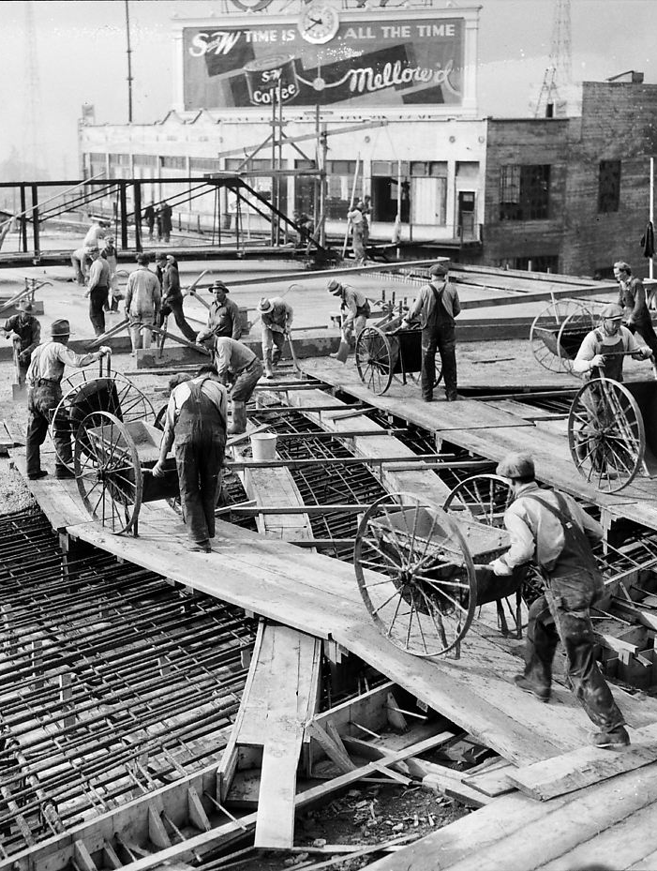
Engineering software is a
Big Job
Many requirements to gather
Many aspects to design
Many features to construct
Many tests to write and run
And much more!
“University Bridge under construction, 1932” by Seattle Municipal Archives
is licensed under CC BY 2.0 / Cropped from original
Notes:
“University Bridge under construction, 1932” by Seattle Municipal Archives is licensed under CC BY 2.0 / Cropped from original
https://flic.kr/p/7jKWYt

Slide 3
Practical Issue
What order should tasks be done in?
That is, what process to use?

Slide 4
The Classic Way:
Waterfall
Requirements
AKA Sequential Process Model
Design
Implementation
⚠️
But often a bad way
Verification
Maintenance
“Waterfall Model” by Paul Smith / Paulsmith99 at en.wikipedia is licensed under CC BY 3.0
Notes:
“Waterfall Model” by Paul Smith / Paulsmith99 at en.wikipedia is licensed under CC BY 3.0
http://en.wikipedia.org/wiki/File:Waterfall_model_%281%29.svg

Slide 5
What could go wrong?
Requirements
6 months
Design
6 months
Implementation
6 months
Verification
6 months
Release!

Slide 6

What could go wrong?
Problem!
Requirements
6 months
Design
6 months
I don’t like it…
Implementation
6 months
Verification
6 months
Release!
Customer

Slide 7
Why Waterfall Fails
False assumption: Specifications are …
  predictable – can be correctly defined at the start
  stable – have low change rates
Actual stats:
  25% of requirements changed 😱
  35% to 50% changed in large projects 😱 😱

Slide 8
Solution:
Empirical
Process Model
Feedback
em·pir·i·cal
/imˈpirək(ə)l/
adjective
based on, concerned with, or verifiable by observation or experience rather than theory or pure logic.
Source: https://languages.oup.com/google-dictionary-en/
Adaptation

Slide 9
Iterative & Incremental Development Process
Analysis &
Design
Requirements
Initial
Planning
Planning
Implementation
Deployment
Evaluation
Testing

Slide 10
Iterative & Incremental Development Process
repeated cycles
Analysis &
Design
Requirements
Initial
Planning
Planning
Implementation
Deployment
Evaluation
Testing

Slide 11
Iterative & Incremental Development Process
build up small portions at a time
Analysis &
Design
Requirements
Initial
Planning
Planning
Implementation
Deployment
Evaluation
Testing

Slide 12
Iterative & Incremental Development Process
Analysis &
Design
Requirements
Initial
Planning
Planning
Implementation
Where are
feedback
&
adaptation?
Deployment
Evaluation
Testing

Slide 13
Iterative & Incremental Development Process
Analysis &
Design
Requirements
Initial
Planning
Adaptation
Planning
Implementation
Feedback
Deployment
Evaluation
Testing

Slide 14
Iterative & Incremental Development:
Key Benefits
Visible early progress
  No “analysis paralysis”
Fail fast
  Catch changing requirements quickly
Course correct quickly
  Reduce wasted effort
Iterative process improvement

Slide 15

Iteration Length?
Short is good
2 to 6 weeks
1 is too short for good feedback
Too long undermines benefits
“TIME” by becosky... is licensed under CC BY-SA 2.0 / Cropped from original
Notes:
“TIME” by becosky... is licensed under CC BY-SA 2.0 / Cropped from original
https://flic.kr/p/632Ye5

Slide 16
Our Project Iterations?
Analysis &
Design
Requirements
M0
Initial
Planning
M1
Planning
Implementation
Deployment
Evaluation
Testing

Slide 17
Summary
Software Engineering Process
Waterfall Process Model
Empirical Process Model
Iterative & Incremental Development
“spiral” by Till Krech is licensed under CC BY-NC-ND 2.0 / Cropped, darkened from original

Slide 18
Appendix: Extras

Slide 19
Developer
Customer
Requirements
Create USs
Estimate USs
USs + Estimates
Prioritize USs
USs + Estimates + Priorities
Choose USs for Iteration
Divide Chosen USs into Tasks
Assign Tasks to Workers
Get to Work!

Slide 20
Estimation is Hard
http://xkcd.com/1658/

Slide 21
Principles for Estimation
Principle: Estimates for smaller, more-immediate tasks tend to be more accurate than ones for larger, more-future tasks
Principle: Past performance is the best indicator of future performance
  Approach: Track your outcomes; refine your estimates
Principle: Wisdom of the crowd
  Goal: Predict how events will unfold
    Think event planning
  Problem: Easy to miss something
  Solution: More brains = more opportunities to catch eventualities

Slide 22
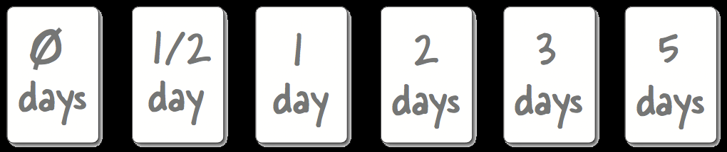
Planning Poker
Estimation Using Wisdom of the Crowd
Cards with days of work
For each US:
  Discuss work involved
  Flip cards
  Repeat until consensus
Efficiency in estimating is important
  Don’t expect your estimates to be super accurate

Slide 23
Here’s a video demonstration of planning poker:
http://youtu.be/0FbnCWWg_NY
Here’s a planning poker web app:
https://planningpokeronline.com/

Slide 24
Principle: Customer sets priorities
Ensures alignment with customer goals
Helps customer feel in control
  Project isn’t going “off the rails”
Estimates help customer maximize cost-benefit

Slide 25
Priority Numbering Scheme
Multiples of 10:
  10 - Highest priority
  20
  30
  40
  50
  … - Lowest priority
Non-multiples of 10 may be used if helpful

Slide 26
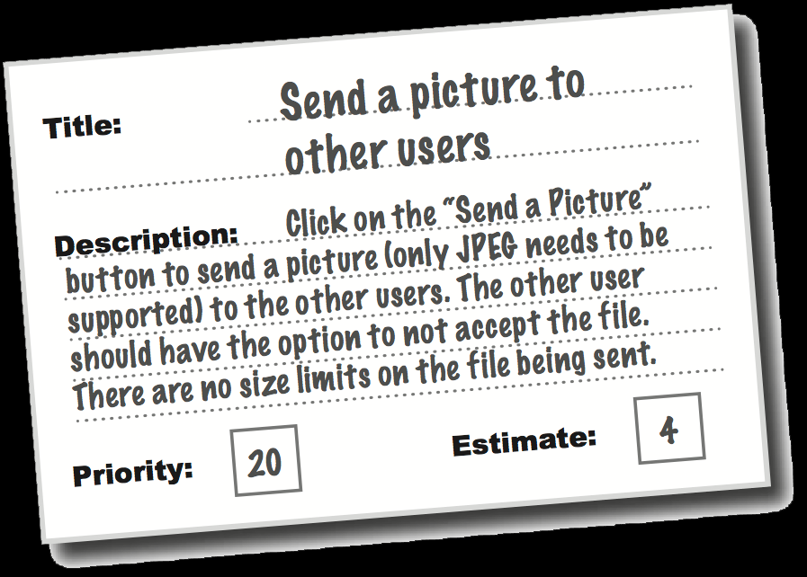
So in the end you have…
Collection of user stories
  With estimates
  And customer priorities

