Slide 1
Software Design Patterns
Photo: “St. Paul's Cathedral, London” © 2016 by Scott D. Fleming is licensed under CC BY-NC 4.0
Notes:
Photo: “St. Paul's Cathedral, London” © 2016 by Scott D. Fleming is licensed under CC BY-NC 4.0

Slide 2
Software Maintenance and Evolution
Post-deployment development activities
  Change software while preserving integrity
  Maintenance older (waterfall) term
  Evolution newer (agile) term
Categories of maintenance
  Correction (corrective, preventative)
  Enhancement (perfective, adaptive)
Why important?
  Software tends to be long lived
  Requirements change, environments change, bugs appear
  Statistic: > 80% of total cost in maintenance 😲

Slide 3
Maintainability and Software Design
Maintainability includes…
Modularity
Understandability
Changeability
Reusability
Transferability
Designing maintainable software is challenging!

Slide 4
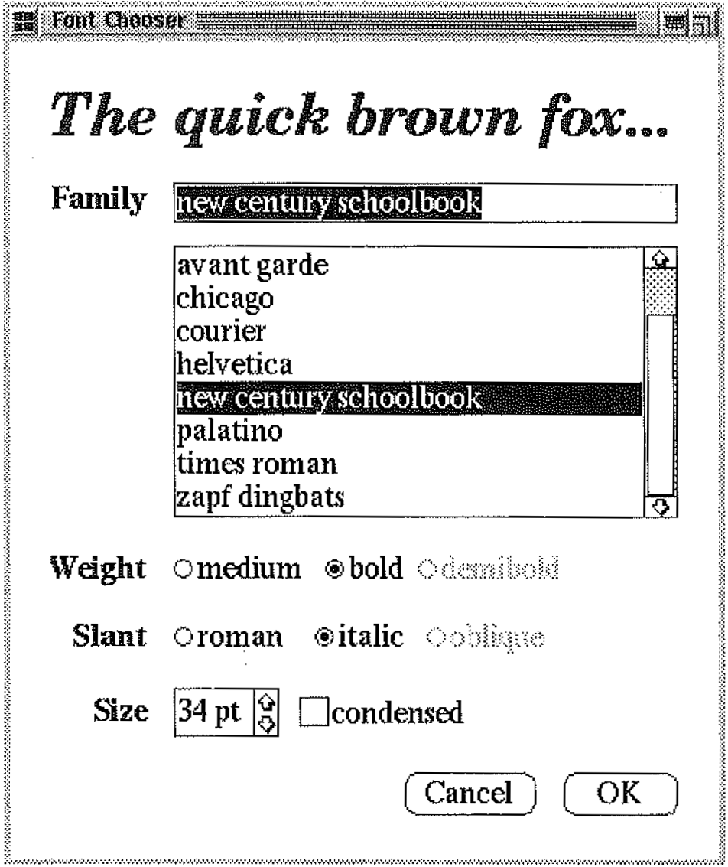
Motivating Example: Font Chooser Dialog

Slide 5
Consider Objects
Label
Entry Field
List Box
Bullet List
Bullet List
Check Box
Spinner
Button
Button

Slide 6
Consider Objects
Label
Entry Field
Each object extends base type to get specialized behavior
Modular design good for reusability
But consider interconnections...
List Box
Bullet List
Bullet List
Check Box
Spinner
Button
Button

Slide 7
When User Interacts with One Widget, Others Must Update
Label
Entry Field
List Box
Bullet List
Bullet List
Check Box
Spinner
Button
Button

Slide 8
When User Interacts with One Widget, Others Must Update
Label
Entry Field
List Box
Bullet List
Bullet List
Check Box
Spinner
Button
Button

Slide 9
When User Interacts with One Widget, Others Must Update
Label
Entry Field
List Box
Bullet List
Bullet List
Check Box
Spinner
Button
Button

Slide 10
When User Interacts with One Widget, Others Must Update
Label
Entry Field
List Box
Bullet List
Bullet List
Check Box
Spinner
Button
Button

Slide 11
What a Mess!
Label
Entry Field
Poor understandability
Poor changeability
Poor reusability
List Box
Bullet List
Bullet List
Check Box
Spinner
Button
Button

Slide 12
Design Patterns
Cupola
Template solutions to common problems
Oculus
Pediment
Cornice
Columns
Portico

Slide 13
Design Patterns:
Benefits
Cupola
Promote quality
  Reusability, maintainability, etc.
Avoid re-inventing solutions
Facilitate communication
Oculus
Pediment
Cornice
Columns
Portico

Slide 14
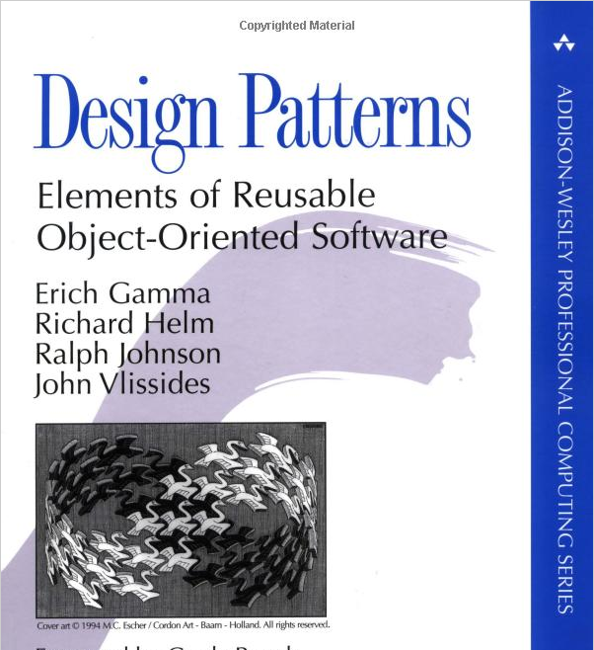
Popularized by “Gang of Four” Book (GoF)
Catalog of 23 patterns
Many now ubiquitous
Must-read for pro devs

Slide 15
How Can Design Patterns Help?
Label
Entry Field
List Box
Bullet List
Bullet List
Check Box
Spinner
Button
Button

Slide 16
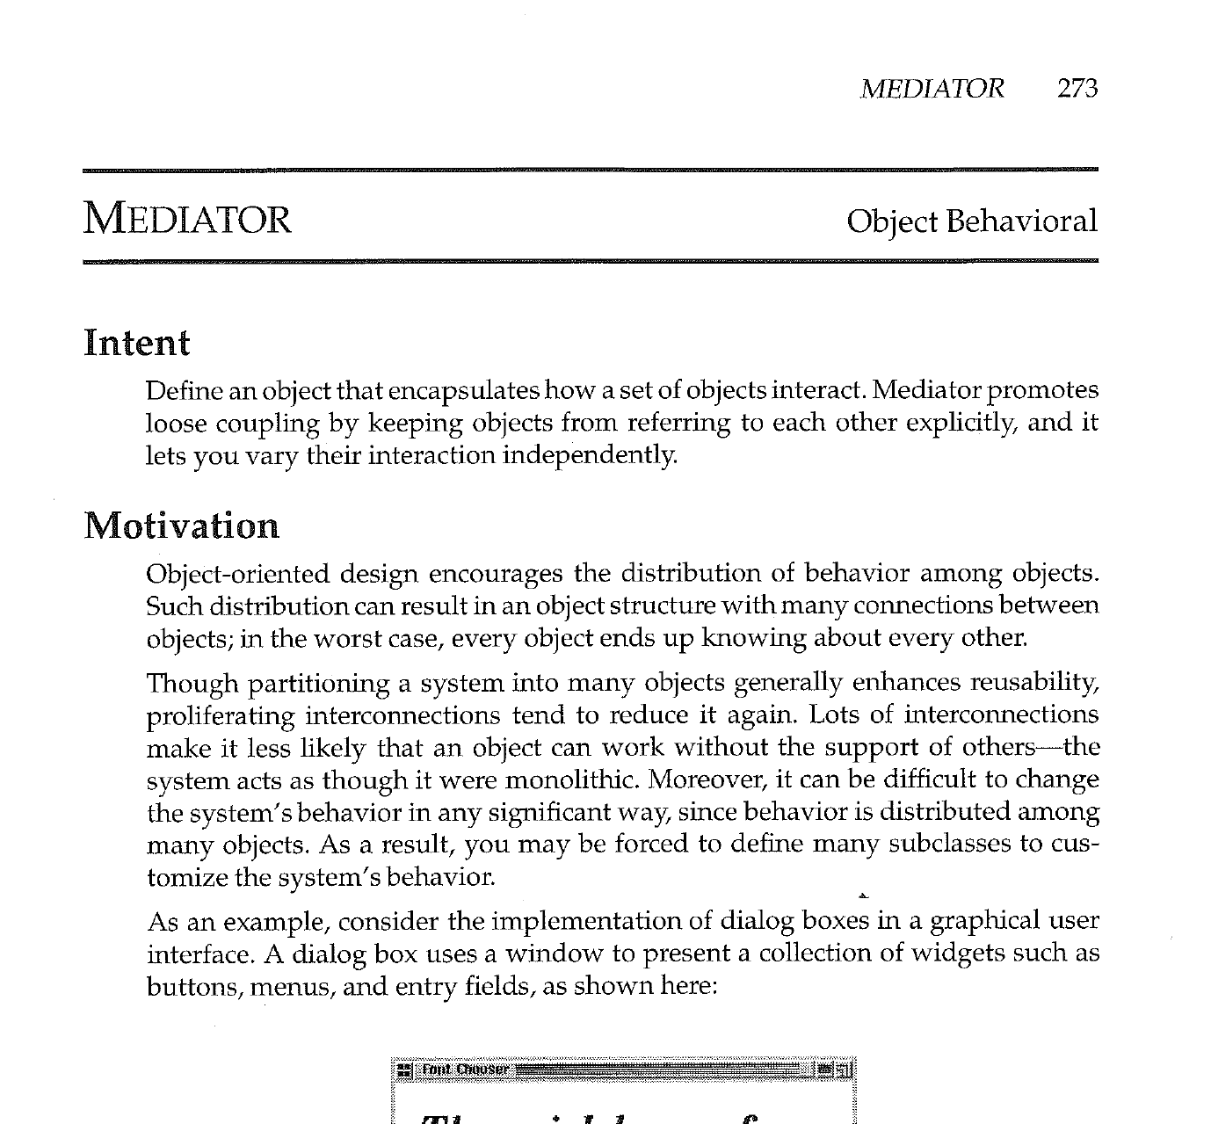
Mediator Pattern
From Gamma et al. Design Patterns: Elements of Reusable Object-Oriented Software

Slide 17
Elements of a Design Pattern in GoF
Intent
Also Known As
Motivation
Applicability
Structure
Participants
Collaborations
Consequences
Implementation
Sample Code
Known Uses
Related Patterns
Mediator Pattern covers in 10 pages

Slide 18
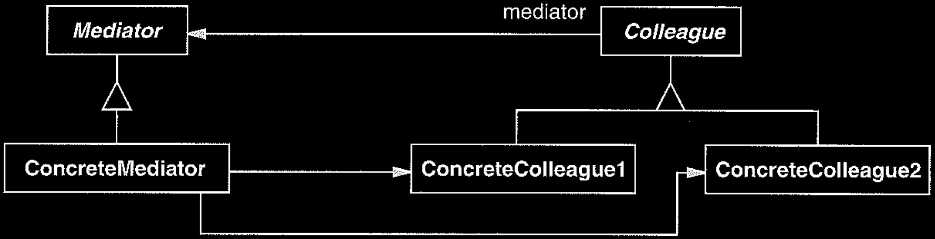
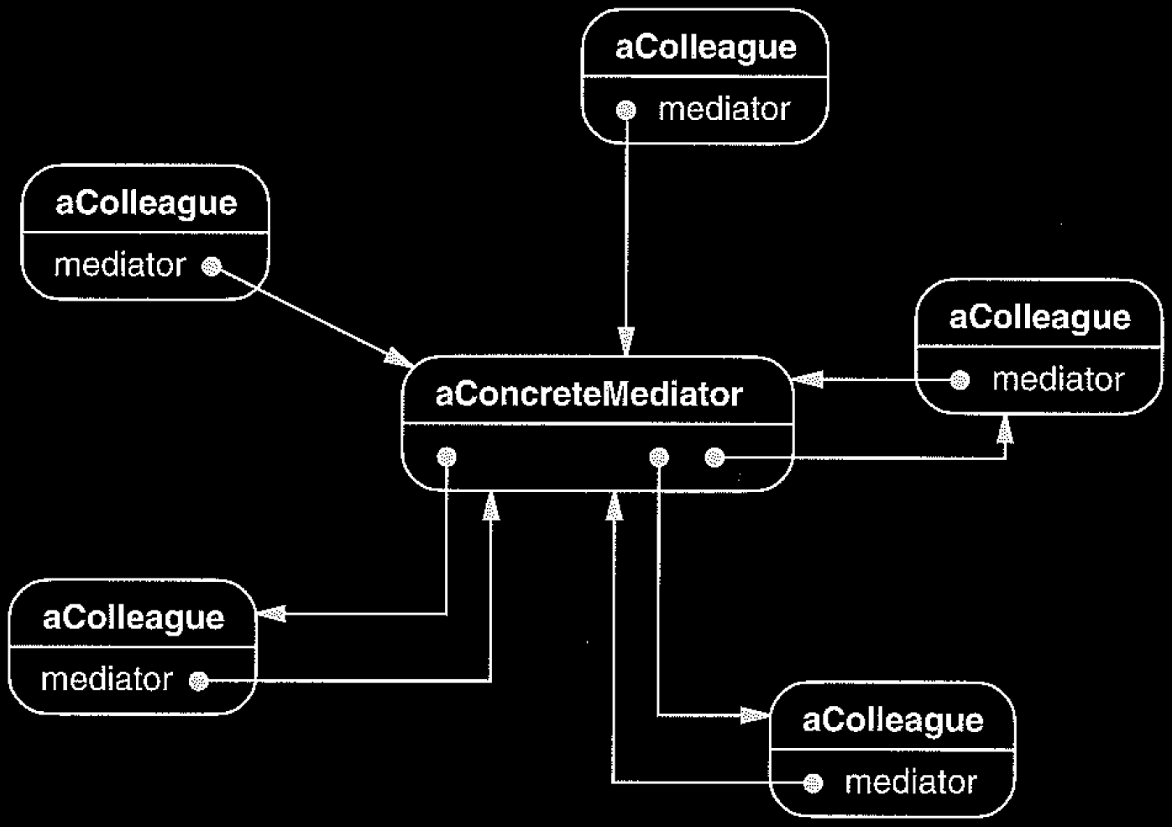
Mediator Structure
Class Diagram
Object Diagram

Slide 19
Applying Mediator to Font Dialog
: FontSampleLabel
: FontFamilyEntryField
: FontFamilyListBox
: FontDialogMediator
: FontWeightBulletList
: FontSlantBulletList
: FontSizeSpinner
:CancelButton
: OkButton
: CondesedFontCheckBox

Slide 20
What Was the Essential Problem?
Label
Entry Field
List Box
Bullet List
Bullet List
Check Box
Spinner
Button
Button

Slide 21
Coupling
Looser Coupling
Measure of how strongly one component...
  is connected to others
  has knowledge of others
  depends on others
Compare loosely versus tightly coupled components
Tighter Coupling

Slide 22
Although metrics have been proposed,
coupling remains difficult to precisely measure
However, intuition about coupling is
useful for informing design decisions
Looser Coupling
Tighter Coupling

Slide 23
Common Types of Coupling in OOP
Class C₁ is coupled to class C₂ if
C₁ has instance variable that refers to C₂
C₁ invokes methods of C₂
C₁ method parameter or local variable references C₂
C₁ is direct or indirect subclass of C₂
Caution! Coupling can also occur in less obvious ways
(e.g., one component having encoded knowledge of others)

Slide 24
Problems with High Coupling
Given class C₁ highly coupled to class C₂ :
Changes in C₂ may force changes in C₁
Harder to understand C₁ in isolation
Harder to reuse C₁ because of dependencies on C₂

Slide 25
Coupling Explains Benefits of Mediator
Tighter Coupling
Looser Coupling

Slide 26
How Does Mediator Reduce Coupling?
Indirection
To decouple two components, assign responsibility to an intermediate component to mediate between the two
Intermediary creates indirection

Slide 27
Summary
Design Patterns
GoF Book
Mediator Pattern
Coupling
Indirection
Photo: “St. Paul's Cathedral, London” © 2016 by Scott D. Fleming is licensed under CC BY-NC 4.0

