Slide 1
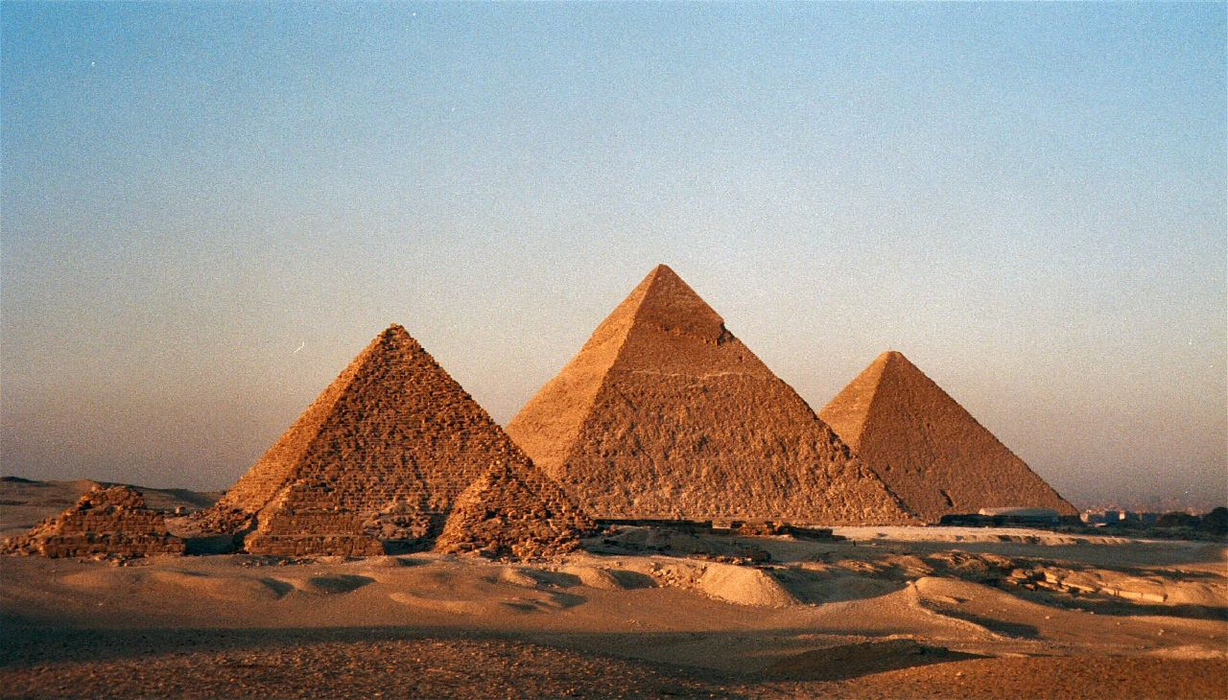
Model Generalization and Inheritance
Photo: "The Pyramids" by Bruno Girin is licensed under CC BY-SA 2.0 / Cropped from original
Notes:
Photo: "The Pyramids" by Bruno Girin is licensed under CC BY-SA 2.0 / Cropped
https://flic.kr/p/2MhiW

Slide 2
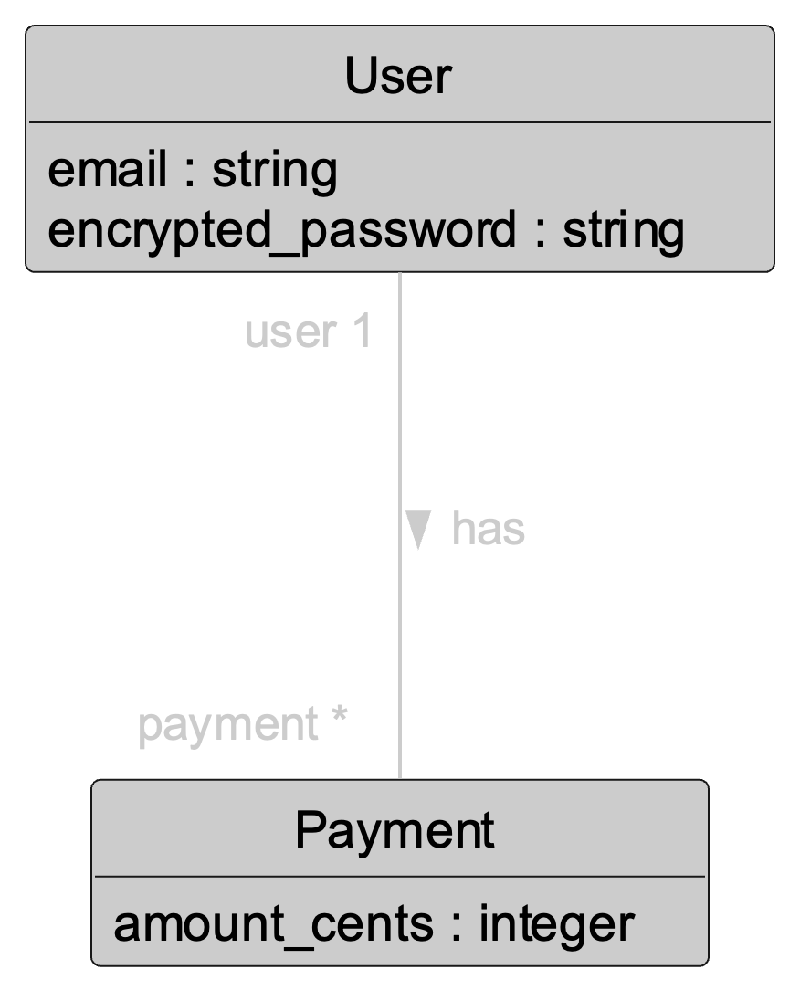
Recall:
Associations to Capture “Has-A” Relationships
Example:
Each User object has many Payment objects.
Each Payment object belongs to one User object.
But there are also “is-a” relationships

Slide 3
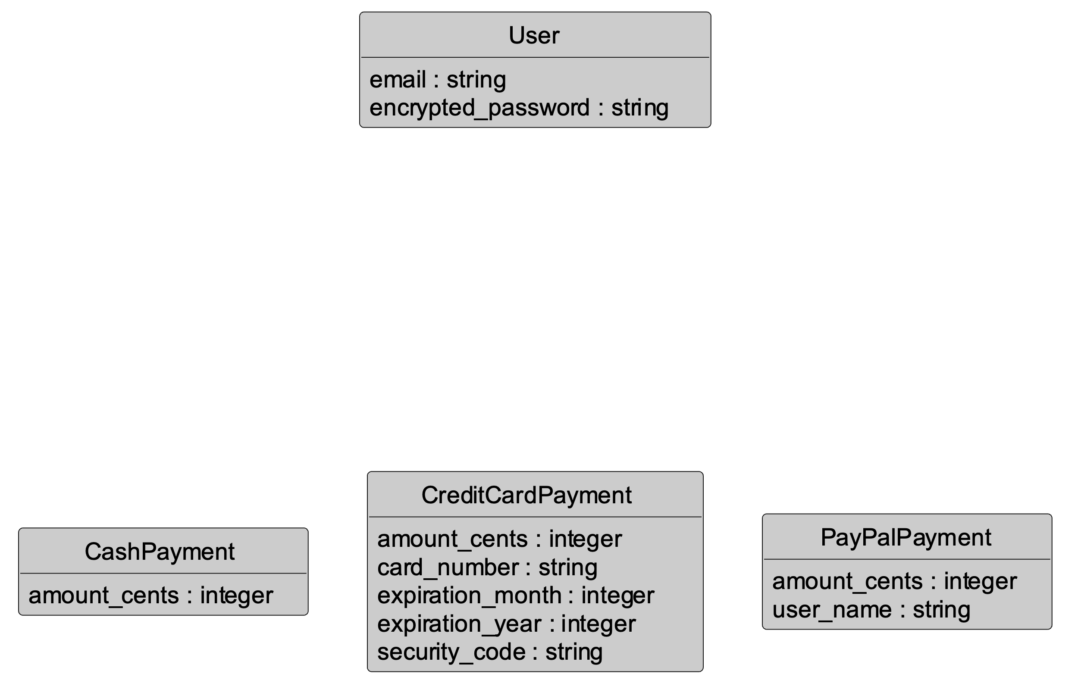
Is-A Example:
Different Kinds of Payments

Slide 4
Is-A Example:
Different Kinds of Payments
Some attributes are the same for all types of payments

Slide 5
Is-A Example:
Different Kinds of Payments
Some attributes are unique to different types of payments

Slide 6
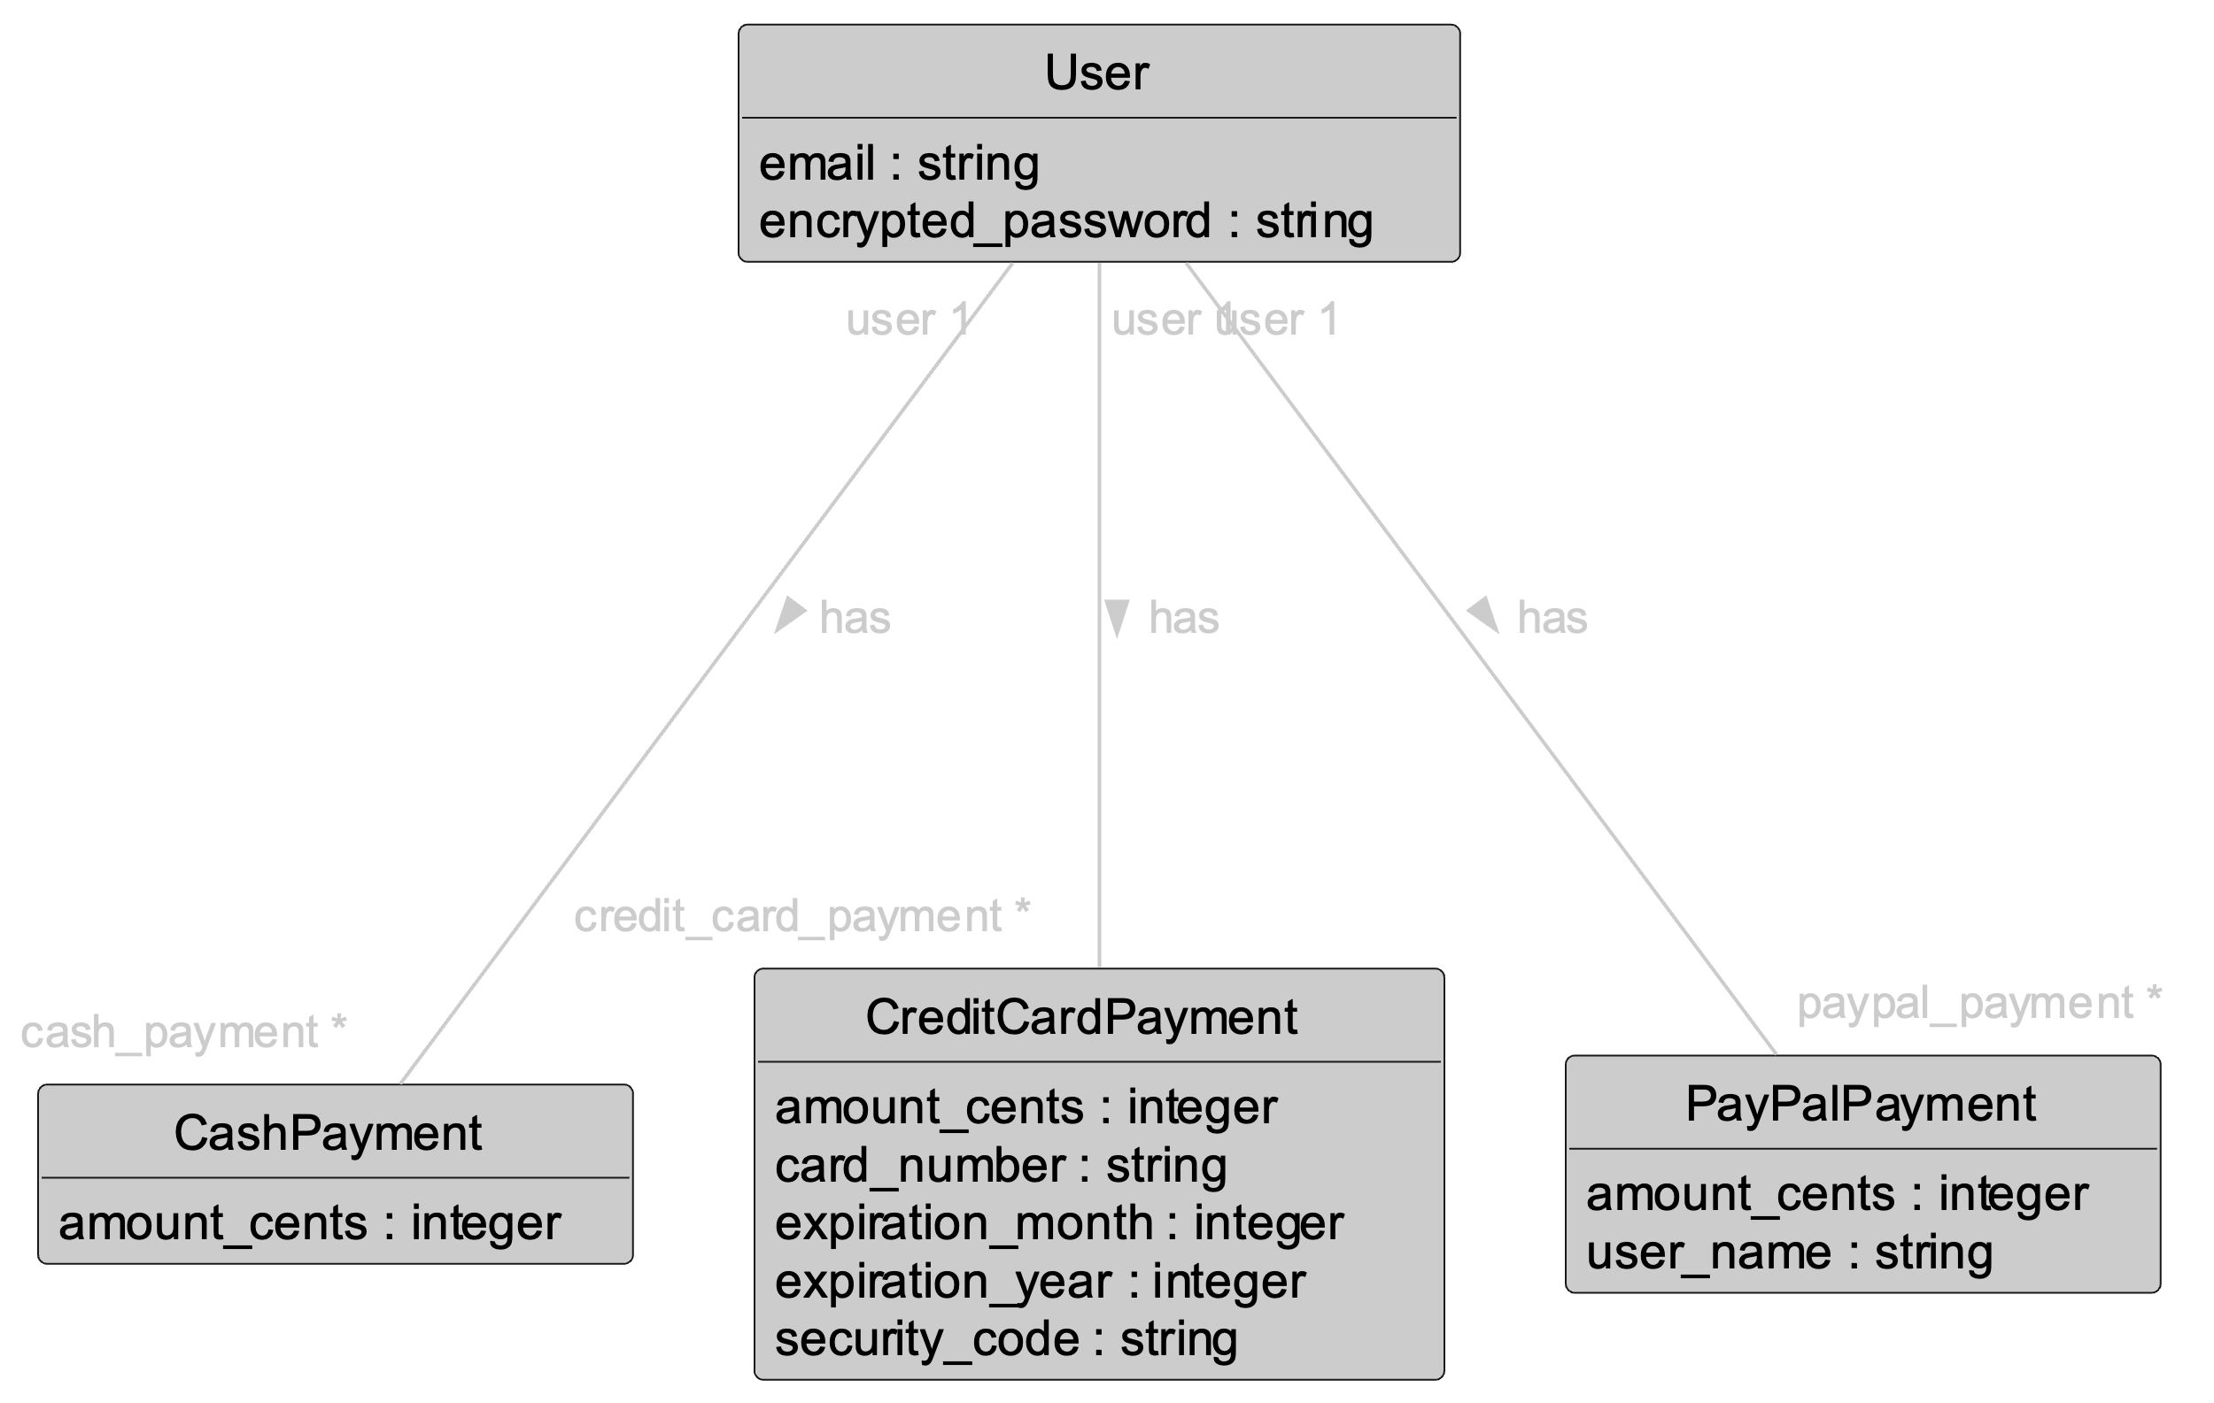
Solution?
Associaton with Each Type
Not ideal 👎
Multiple collections to search/manage

Slide 7
Key Issue:
Each is-a Payment
We want one unified collection of payments

Slide 8
Solution:
Pull Out Common Features into Base Class
AKA Superclass
Subclasses inherit from base class

Slide 9
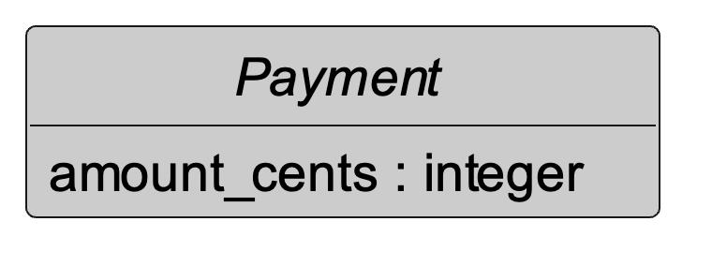
Abstract Base Class Payment
Italics denote abstract
Abstract implies we never have just a Payment object
  Never instantiate Payment

Slide 10
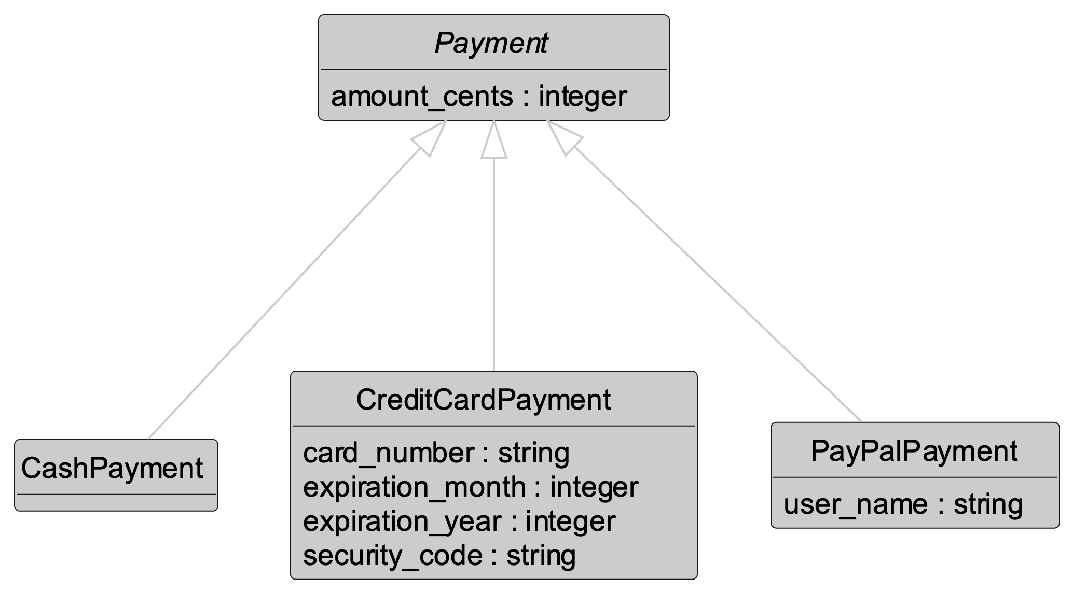
Inheritance Relationship
Triangle arrowhead denotes inheritance (AKA generalization)

Slide 11
Inheritance Relationship
Common features go in base class
Subclasses inherit amount_cents attribute from base class

Slide 12
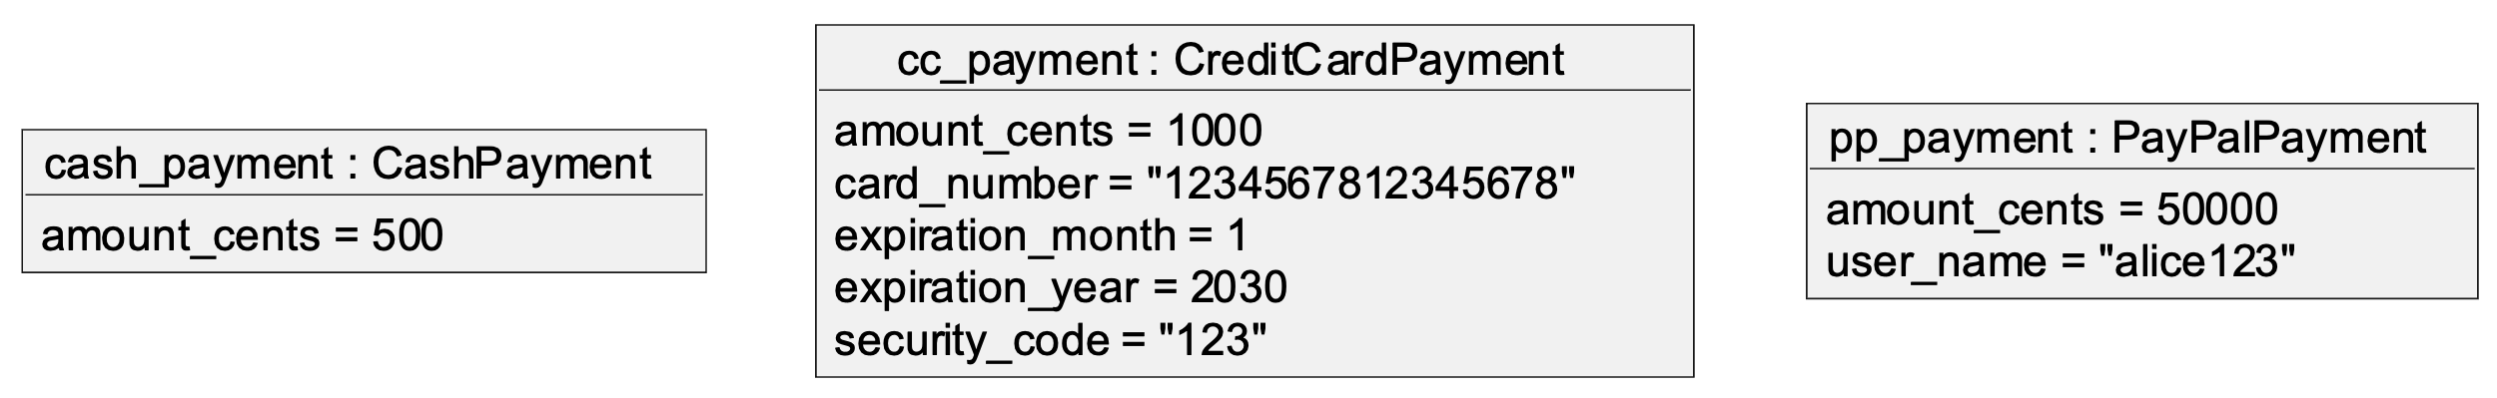
Example Subclass Objects
Subclass objects include
attributes (and methods and associations)
inherited from base classes

Slide 13
Inheritance Relationship
Each subclass is-a payment

Slide 14
The Is-A Rule
For a generalization to be valid, the following statement must be true for all subclass objects:
A <subclass object> is a <base class object>.
Examples:
A cash payment is a payment.
A credit payment is a payment.
A PayPal payment is a payment.
Implication: All features (attributes, methods, associations, etc.) of base class must be applicable to subclass

Slide 15
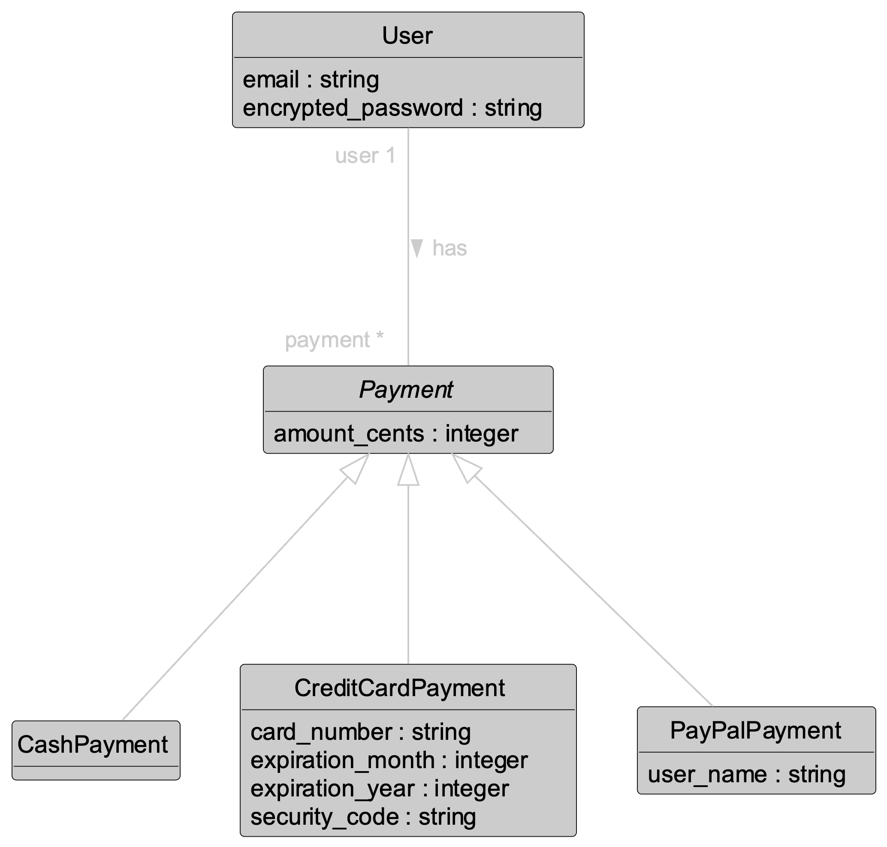
Final Design:
User Has Many Payments
One collection of “payments”
Each payment is subclass object

Slide 16
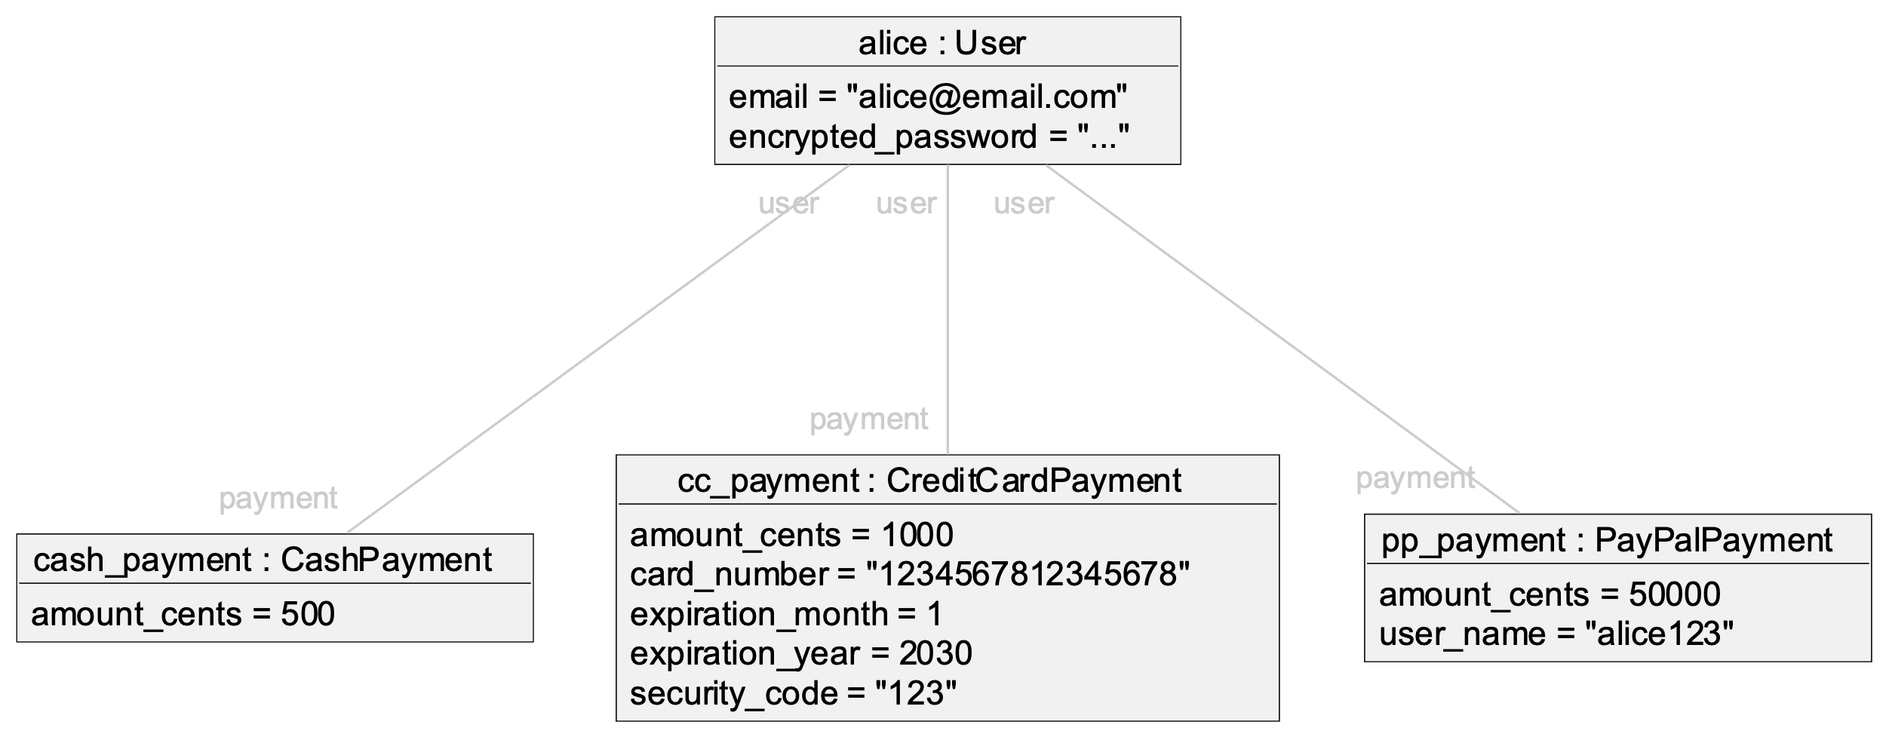
Example Instantiation

Slide 17
Example Instantiation
Same payments collection

Slide 18
Example Instantiation
Different types

Slide 19
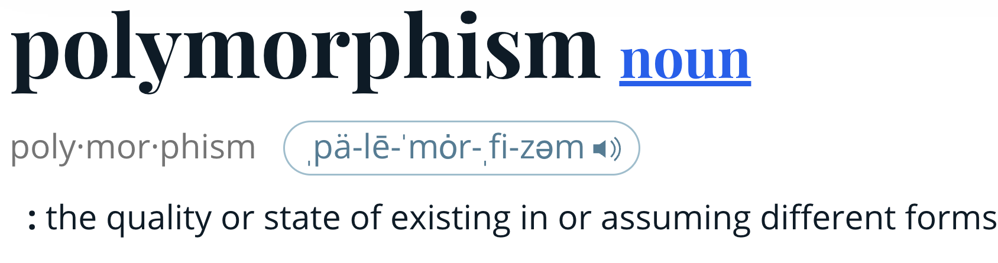
Source: https://www.merriam-webster.com/dictionary/polymorphic

Slide 20
Polymorphic Association
Polymorphism – one symbol represents multiple different types
Association links can connect to different types of payment objects
(subtype polymorphism)

Slide 21
Bad News:
Rails Model Support Limited
Single Table Inheritance (STI)
  Limitation: All attributes shared by all subclasses (only methods vary)
Polymorphic Associations
  Limitation: Only for class belongs to different classes
    Not for class has many different subclasses
    Meant for general sorts of data shared by variety of models, like images, messages
Delegated Types
  Shared attributes in superclass table, separate tables for subclasses
  Limitation: Complex to set up and use
See Rails Guides: Active Record Associations for more details

Slide 22
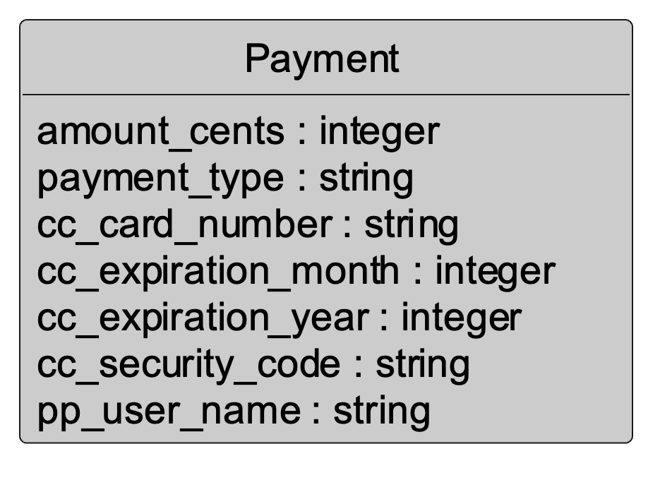
Advise for Student Projects:
Combine All Base/Subclasses into One Class
Shared by all
Credit-card specific
PayPal specific

Slide 23
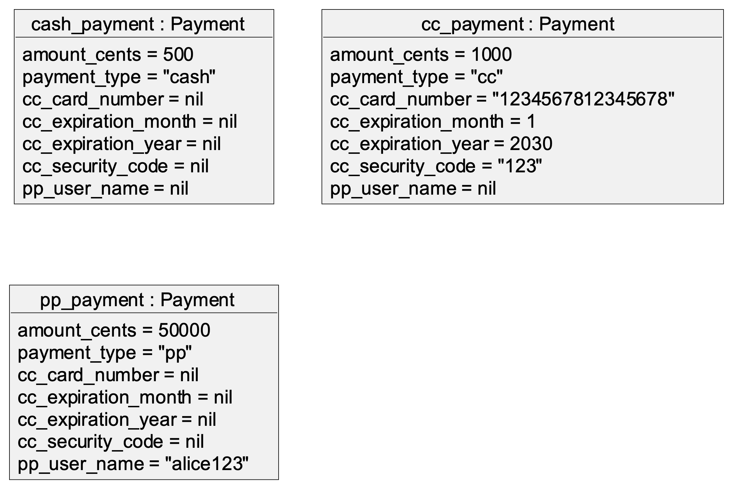
Example Objects
Critique: Wasteful of space, but straightforward to implement

Slide 24
Summary
Inheritance and generalization
  Is-A relationship
  Base classes and subclasses
Polymorphism
  Subtype polymorphism
"The Pyramids" by Bruno Girin is licensed under CC BY-SA 2.0 / Cropped, darkened from original

