Slide 1
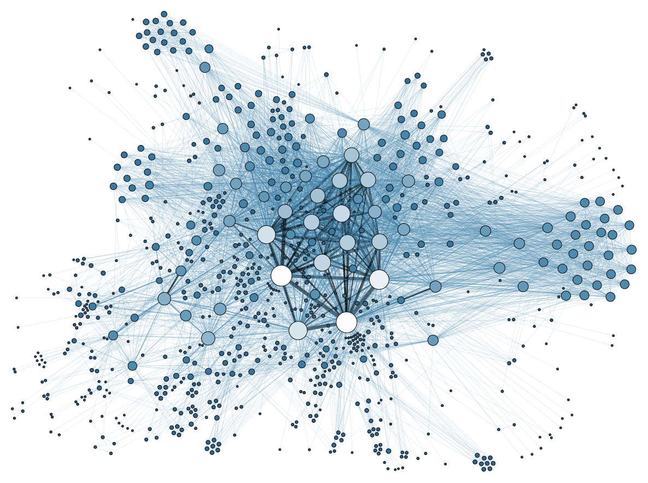
Model Associations
Image: "Social Network Analysis Visualization" by Martin Grandjean, used under CC BY-SA 3.0 / Cropped
Notes:
Image: "Social Network Analysis Visualization" by Martin Grandjean, used under CC BY-SA 3.0 / Cropped

Slide 2
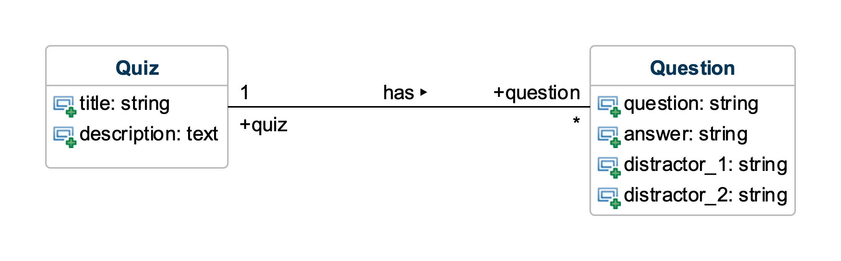
Notes:
Consider these model classes from a quizzing app.
The Quiz model class represents quizzes that have titles and descriptions.
The Question model classes represents multiple-choice questions with questions, answers, and distractors.

Slide 3
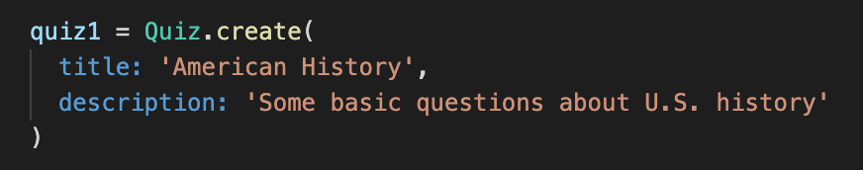
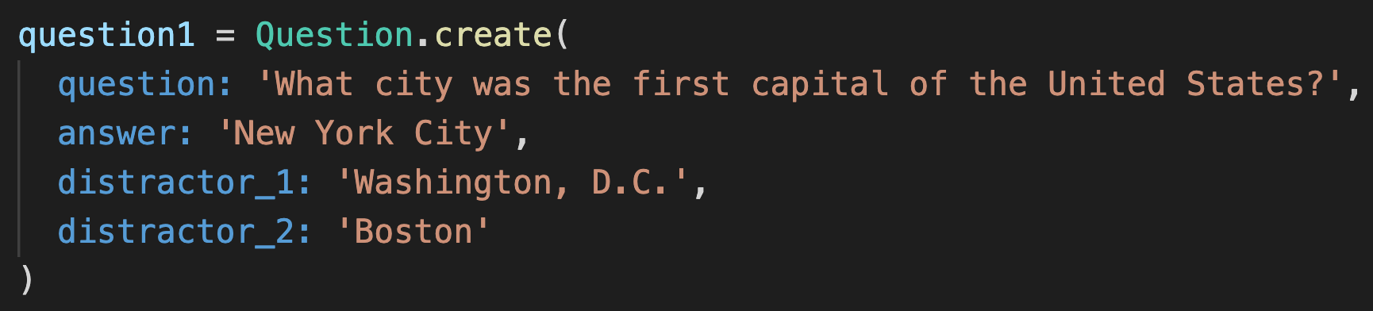
Notes:
You can create instances of these model classes and save them to the database with code like this.

Slide 4
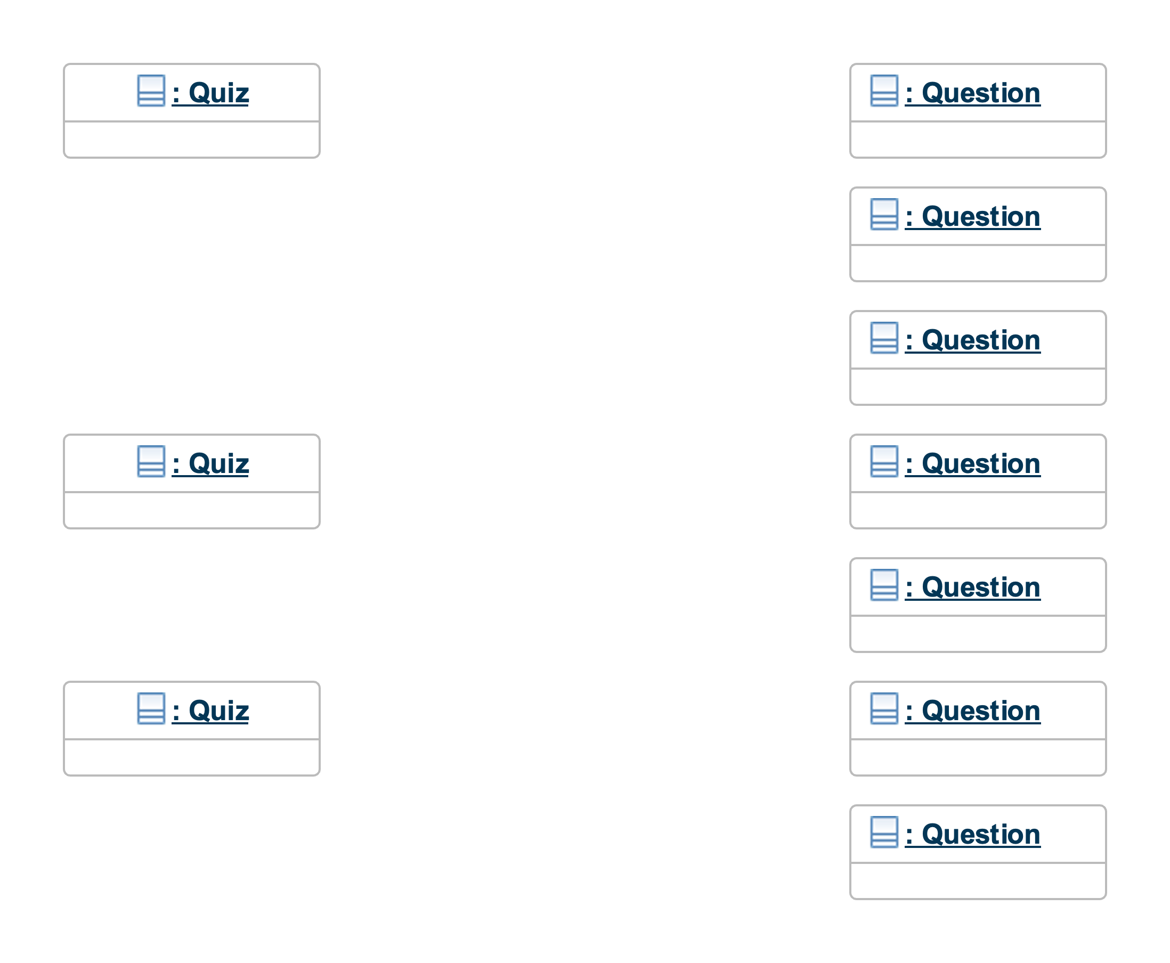
Notes:
Here is an object diagram that shows a snapshot of a running system.
Three Quiz objects have been created.
Seven Question objects have been created.
Here’s the problem: We want for certain questions to belong to certain quizzes.
However, those Quiz-Question relationships are not captured here.
We have no way of knowing which Question object belongs to which Quiz object.

Slide 5
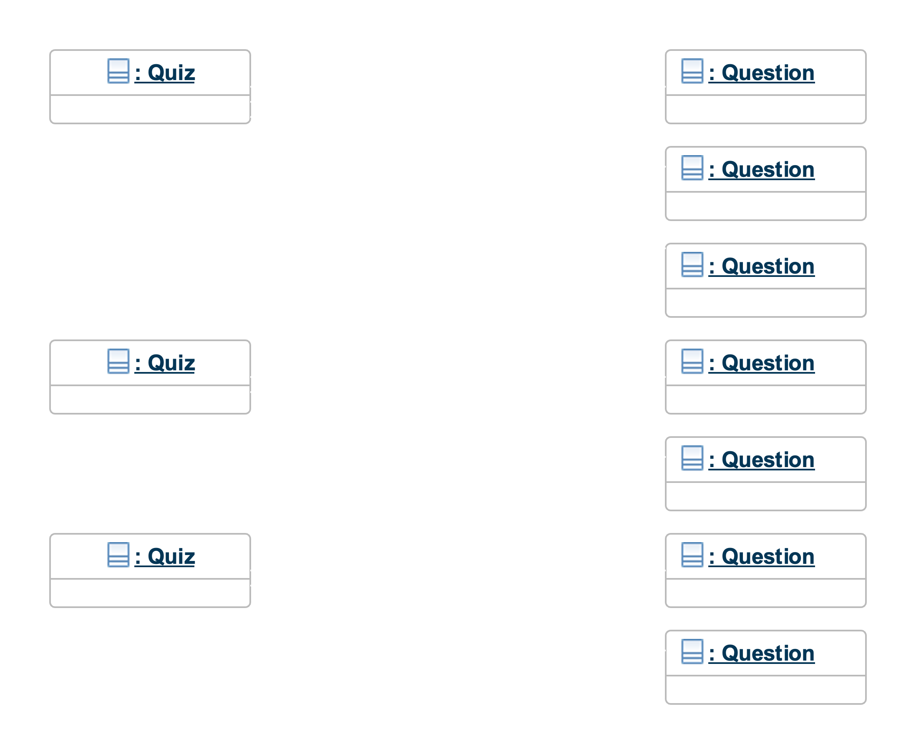
Notes:
What we’d really like is something like this.
Each Question object has a ”link” to the Quiz object to which it belongs.
Now we can tell which Question object belongs to which Quiz object.

Slide 6
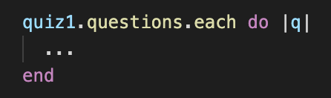

Notes:
Having such links would also enable us to conveniently access related Quiz and Question objects.
For example, if we have a Quiz object referenced by a variable quiz1, we can access an array of the Question objects that belong to that Quiz object by calling a method of Quiz (named questions in this case).
Since questions returns an array, we can, for example, iterate through all the Question objects in the array using a call to each, as shown above.
Similarly, if we have a Question object referenced by a variable question1, we can access the quiz to which it belongs with a simple call to a method of Question (the method named quiz in this case).
But how do we set this up in Rails?

Slide 7
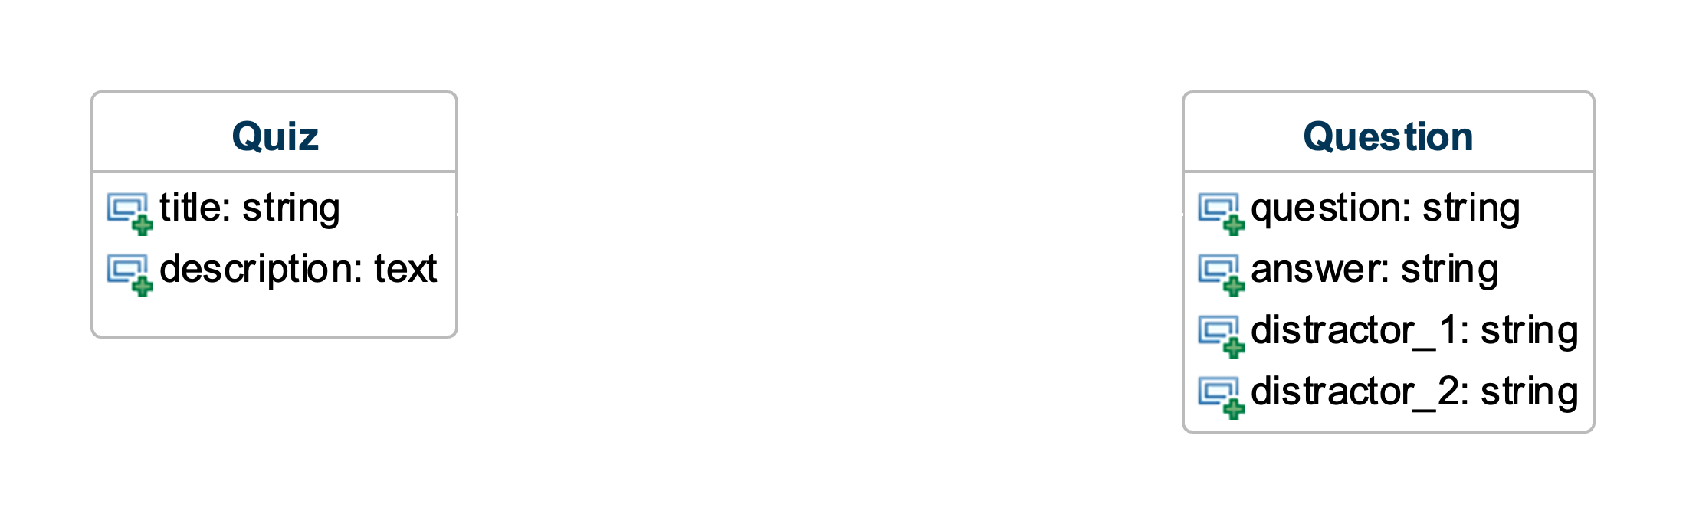
Notes:
To set up these links between objects and methods to make use of them in Rails, we must create a class association between the model classes.
Here is a class diagram depicting an association between the Quiz and Question classes.

Slide 8
Notes:
Having an association (line) connecting two classes means that association links can be created between instances of these classes.

Slide 9
Notes:
The various annotations on the class association line serve a few purposes.

Slide 10
Notes:
The association name helps to describe what the association means or what purpose the association serves.
The triangle specifies the reading direction for the association.
In this case, we would read it as “Quiz has Question”.
If we wanted to read it in the other direction, it would be “Question belongs to Quiz”.
For modeling Rails model classes, our association names will always be “has”.

Slide 11
Notes:
The “1” and “*” annotations are called multiplicities.
Multiplicities constrain how the links between objects can be created.
The “1” annotation means exactly 1.
The “*” annotation means zero or more.
To interpret the meaning of these multiplicities with respect to the classes in the diagram, there is a special way of constructing a sentence that uses them.

Slide 12
“ Each Quiz has zero or more Questions ”
Notes:
To interpret the “*” multiplicity, we make a sentence like this.
Note how we made the sentence.
Start with “Each”.
Name of class on the opposite side from the multiplicity (“Quiz”).
Association name (“has”).
Multiplicity of interest (“*”).

Slide 13
“ Each Question
belongs to
one
Quiz ”
Notes:
To interpret the ”1” multiplicity, we make a sentence like this.
Note that since we are reading the association in the opposite direction, we must use the inverse of “has”, which is “belongs to”.

Slide 14
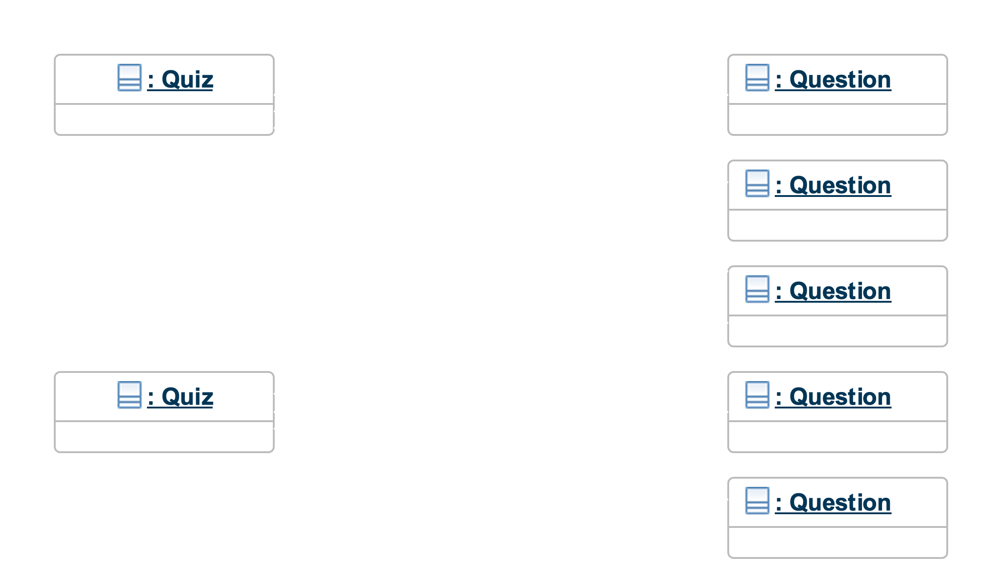
Valid?
Valid?
Notes:
Recall that multiplicities constrain what configurations of objects are valid.
Look at each of the object diagrams.
Given the multiplicities in the class diagrams, for each object diagram, tell whether the diagram is valid or invalid.

Slide 15
✓
Valid?
Valid?
Notes:
The first diagram is valid, because it is consistent with the specified multiplicities.
Each Quiz has zero or more Questions.
Each Question belongs to one Quiz.

Slide 16
✓
Valid?
✕
Valid?
✕
✕
Notes:
The second diagram is not valid with respect to the multiplicities.
Although it is true that each Quiz has zero or more Questions…
It is not true that each Question belongs to one Quiz.
In fact, there is one Question that belongs to two different Quizzes.
Thus, this diagram is not consistent with the ”1” multiplicity in the diagram.

Slide 17
Notes:
Finally, the labels on either end of the association are called roles in the class diagram notation.
However, we can think of these as attribute names for the object(s) on the other side of an association link(s).
For example, it’s like Quiz has an additional attribute question.
And Question has an additional attribute Quiz.
The “+” plus sign next to each role specifies that the role has public visibility (similar to the class attributes in the above diagram).

Slide 18
Notes:
When diagramming our Rails model classes, we will make the role names match the names of the methods for accessing associated objects.
Important! Note that when we have a “*” (zero or more; aka many) multiplicity, the corresponding role name will be singular in the diagram (due to how the class diagram notation wants it), but the name of the method will be plural to capture the fact that the method returns an array of objects.

Slide 19
Steps to Code an Association in Rails
Add a foreign key column to the many-side model table
Add has-many/belongs-to declarations to the model classes

Slide 20
Steps to Code an Association in Rails
Add a foreign key column to the many-side model table
Add has-many/belongs-to declarations to the model classes

Slide 21
Keys in Relational Databases
Primary Key: Uniquely identifies each record in table
Foreign Key: Reference to primary key in another table

Slide 22
quizzes
id | title | description
32 | … | …
44 | … | …
questions
id | question | answer | distractor_1 | distractor_2
16 | … | … | … | …
22 | … | … | … | …
Notes:
Let’s begin with the usual Rails-ORM-compliant tables for our model classes.
The id column in each table holds primary keys.

Slide 23
quizzes
id | title | description
32 | … | …
44 | … | …
questions
id | question | answer | distractor_1 | distractor_2 | quiz_id
16 | … | … | … | …
22 | … | … | … | …
Notes:
To record the association links, we must add a foreign key column.
Foreign key columns hold the values of primary keys (id attributes in this case) from another table as a way to create links between the rows in one table and the rows in the other.

Slide 24
quizzes
id | title | description
32 | … | …
44 | … | …
questions
id | question | answer | distractor_1 | distractor_2 | quiz_id
16 | … | … | … | … | 32
22 | … | … | … | …
Notes:
For example, if the Question with id 16 belonged to the Quiz with id 32, the quiz_id value for the Question would be 32.

Slide 25
quizzes
id | title | description
32 | … | …
44 | … | …
questions
id | question | answer | distractor_1 | distractor_2 | quiz_id
16 | … | … | … | … | 32
22 | … | … | … | … | 44
Notes:
Similarly, if the Question with id 22 belonged to the Quiz with id 44, the quiz_id value for the Question would be 44.

Slide 26
questions
id | question | answer | distractor_1 | distractor_2 | quiz_id
16 | … | … | … | … | 32
22 | … | … | … | … | 44
Notes:
To add a foreign key column to an existing table, we must first generate a migration (that does nothing for now).

Slide 27
questions
id | question | answer | distractor_1 | distractor_2 | quiz_id
16 | … | … | … | … | 32
22 | … | … | … | … | 44
Add QuizFkCol To Questions
Always “Add”
Your Choice
Always “To”
Table Name
Notes:
Note the naming convention for the migration name.

Slide 28
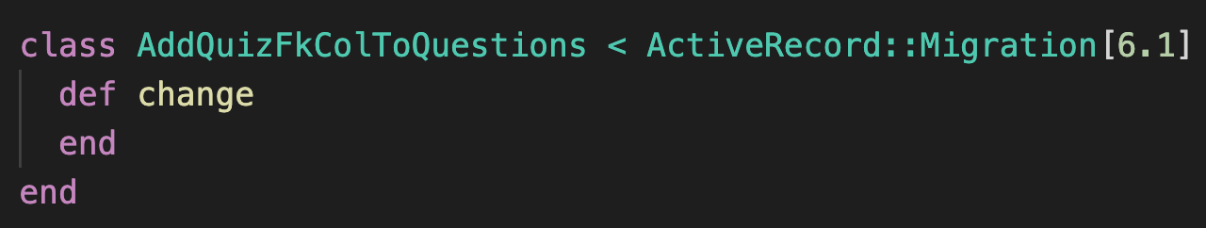
questions
id | question | answer | distractor_1 | distractor_2 | quiz_id
16 | … | … | … | … | 32
22 | … | … | … | … | 44
Notes:
The rails generate command generates a migration that looks like this.

Slide 29
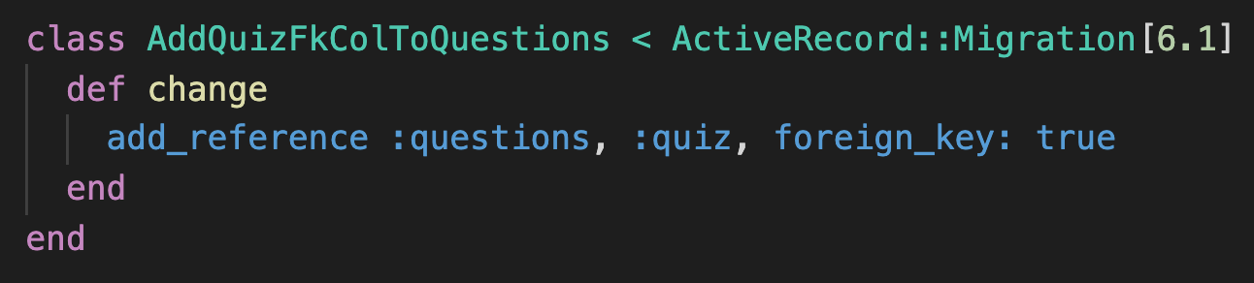
questions
id | question | answer | distractor_1 | distractor_2 | quiz_id
16 | … | … | … | … | 32
22 | … | … | … | … | 44
Notes:
We must add an add_reference call to the migration to make it add the column to the table.

Slide 30
questions
id | question | answer | distractor_1 | distractor_2 | quiz_id
16 | … | … | … | … | 32
22 | … | … | … | … | 44
Name of table
Name of column to be added
(“_id” will be automatically appended)
Notes:
Note what the names in the call refer to.
Also note that Rails uses the name “:quiz” to infer that the table with the primary keys is “quizzes”.
If you wanted to use a different name for the column, you would have to write the foreign_key argument like this:
foreign_key: { to_table: :quizzes }

Slide 31

questions
id | question | answer | distractor_1 | distractor_2 | quiz_id
16 | … | … | … | … | 32
22 | … | … | … | … | 44
Notes:
Lastly, we must run the migration script to apply the change to the database table.

Slide 32
Steps to Code an Association in Rails
Add a foreign key column to the many-side model table
Add has-many/belongs-to declarations to the model classes

Slide 33
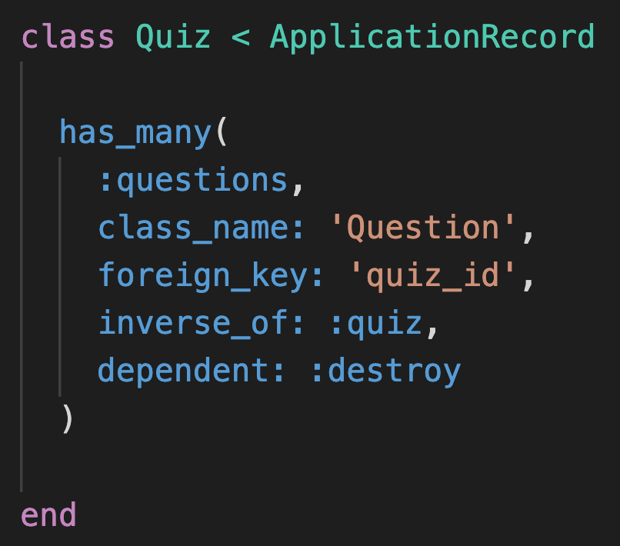
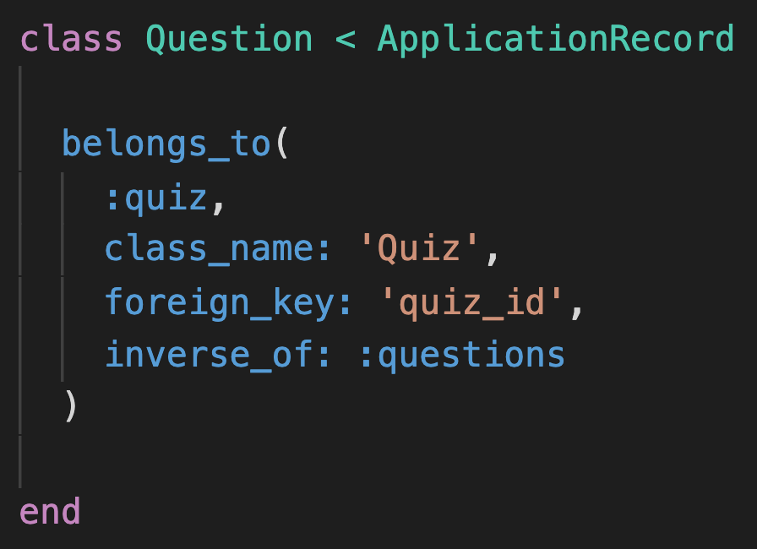
Notes:
The has_many and belongs_to declarations tell Rails how to setup the association.

Slide 34
Notes:
Note where the has_many declaration comes from with respect to the class diagram.

Slide 35
Notes:
Similarly, note where the belongs_to declaration comes from with respect to the diagram.

Slide 36
Notes:
The first argument corresponds to the role names in the class diagram and will be the name of the method for accessing linked objects.
For example, Quiz will now have an instance method questions that returns the array of Question objects that belong to the Quiz.
Similarly, Question will now have an instance method quiz that returns the Quiz object to which the Question belongs.
Don’t forget that in the class diagram, these names are always singular, but we pluralize the name in the has_many declaration to reflect that fact that the method will return an array.

Slide 37
Notes:
The class_name argument specifies the name of the other class in the association.

Slide 38
questions
id | question | answer | distractor_1 | distractor_2 | quiz_id
16 | … | … | … | … | 32
22 | … | … | … | … | 44
Notes:
The foreign_key argument specifies the name of the foreign key column in the table on the belongs-to side that will be used to refer to rows on the has-many side.

Slide 39
Notes:
The inverse_of argument specifies the first argument to the declaration on the other side of the association.
The purpose of this argument is a bit subtle, but suffice it to say that it prevents some strange, undesirable program behaviors.

Slide 40
✕
✕
✕
✕
Notes:
The dependent: :destroy argument on the has_many side specifies that if a Quiz object is destroyed then all its Question objects should automatically be destroyed as well.

Slide 41
What do the has_many and belongs_to declarations get us?

Slide 42
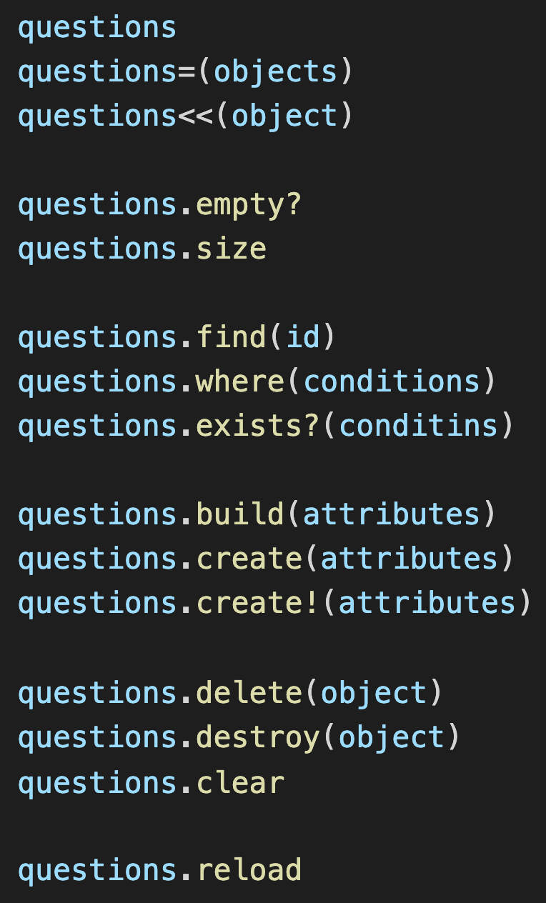
See Rails Guides Method Reference
Notes:
Once we have setup our association, Rails provides a number of methods that we can use for CRUDing associated objects.
Here are most of the methods provided by the has_many declaration.

Slide 43
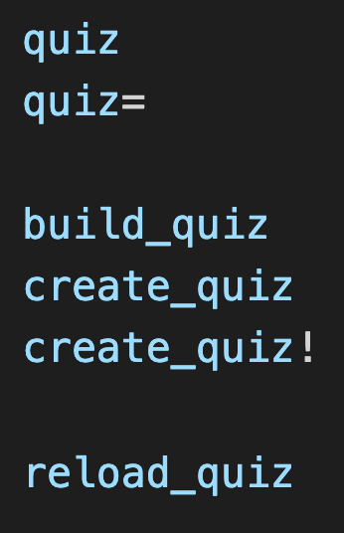
See Rails Guides Method Reference
Notes:
Here are the methods provided by the belongs_to declaration.

Slide 44
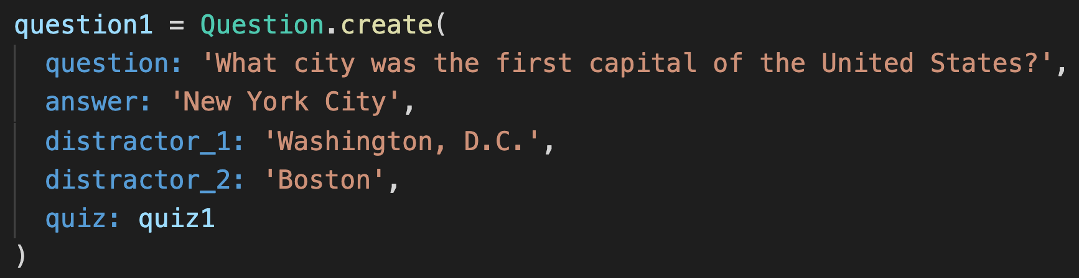
Notes:
The belongs_to declaration also provides a special attribute you can pass to constructors to set the parent object.

Slide 45
Summary
Class associations
Association links between objects
Multiplicities
Associations in Rails
  ORM
  Foreign keys in DB relations
  has_many/belongs_to declarations

