Slide 1
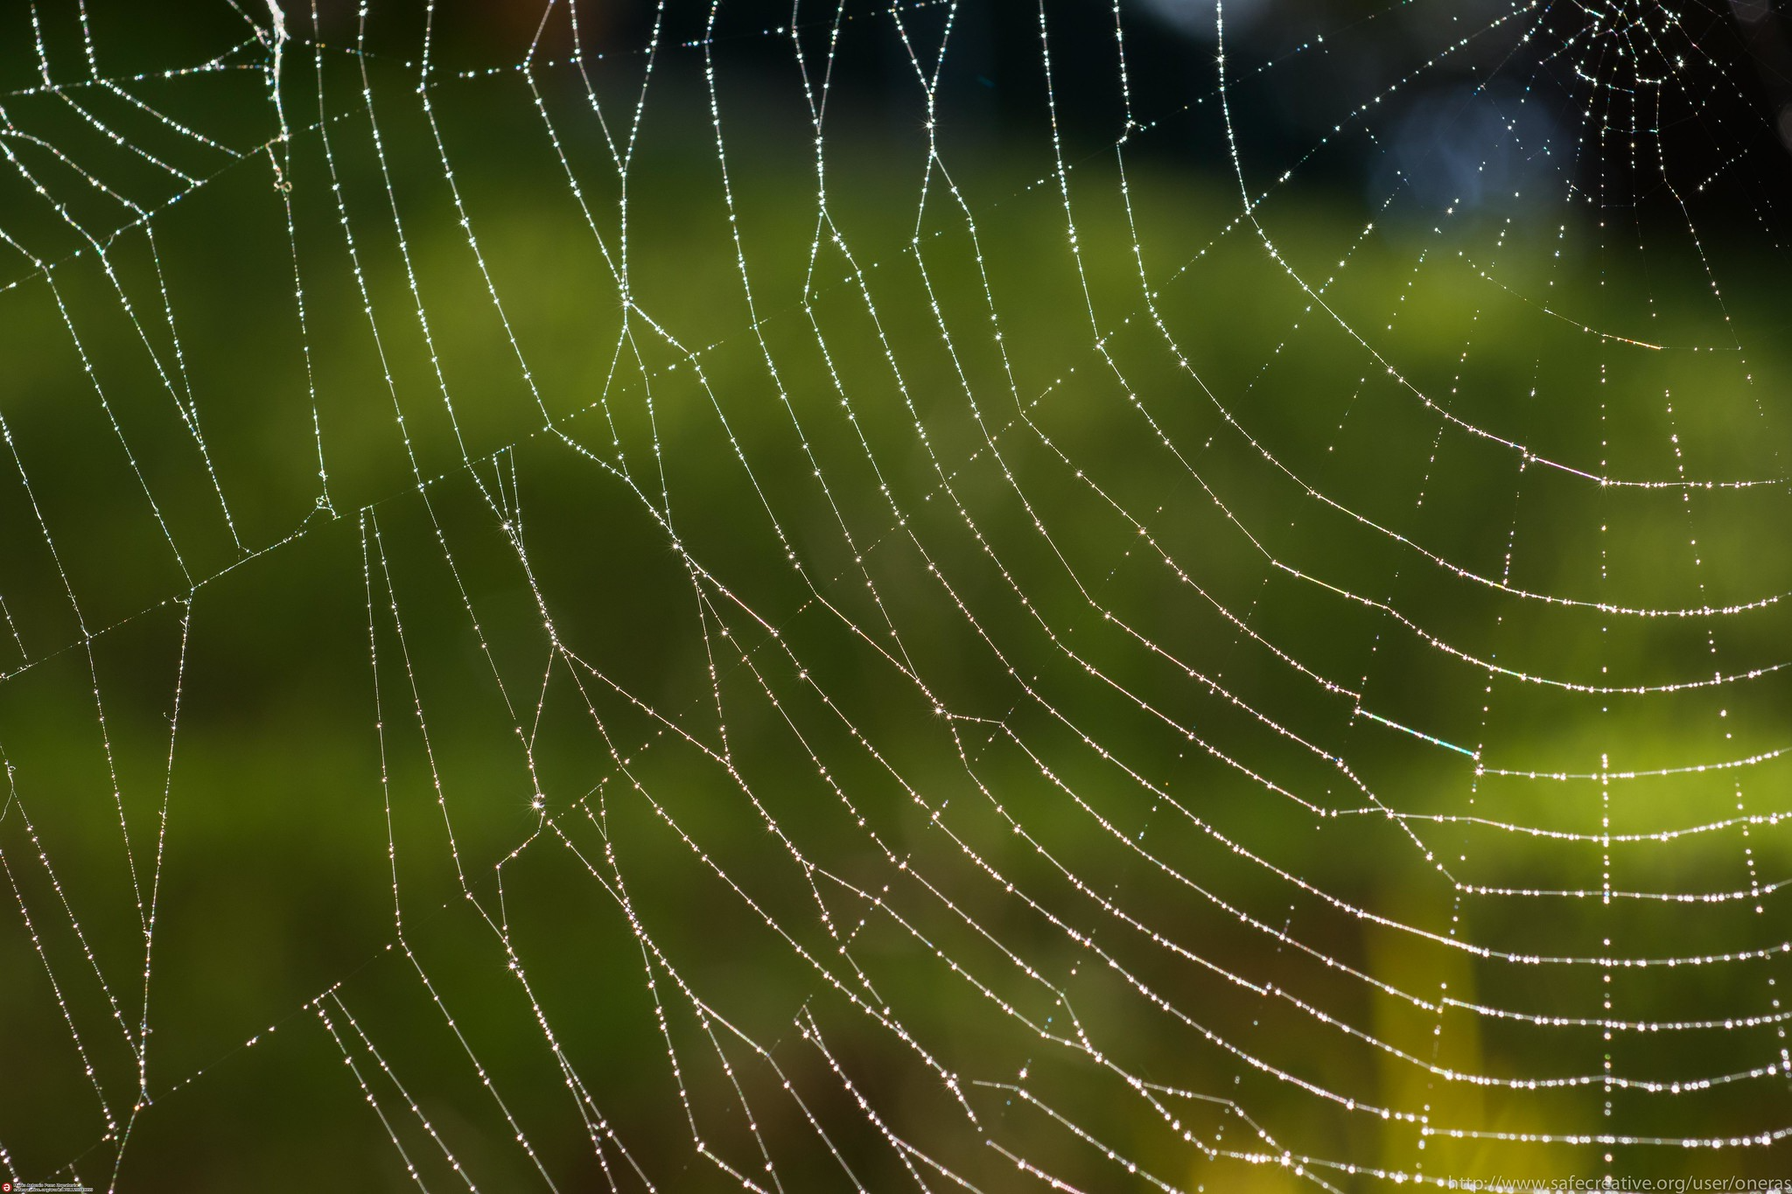
HTTP and the Web
“spider web” by Mario A. P. is licensed under CC BY-SA 2.0 / Cropped from original
Notes:
“spider web” by Mario A. P. is licensed under CC BY-SA 2.0 / Cropped from original
https://flic.kr/p/R6Bfo3

Slide 2
So how does the Web work?
When you open a web page in your browser,
where does that HTML come from, and
how does it get to your browser?

Slide 3
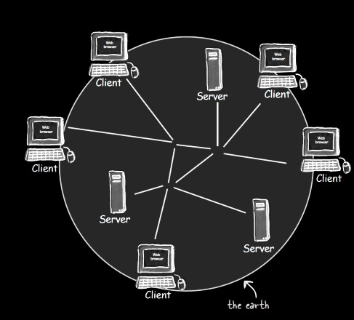
Client-Server Architecture of the Web
Head First Servlets and JSP (2nd edition), p. 3
From Head First Servlets and JSP (2nd edition), p. 4

Slide 4
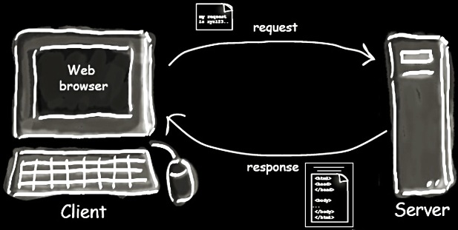
Client-Server Interaction
From Head First Servlets and JSP (2nd edition), p. 4

Slide 5
How do you tell a browser to send a request to a particular server?
?
Head First Servlets and JSP (2nd edition), p. 3

Slide 6
URL (Uniform Resource Locator)
http://www.wickedlysmart.com:80/beeradvice/select/beer1.html
Port (optional)
Resource Path
Protocol (http, https, etc.)
Domain Name (web server)

Slide 7
What protocol do these interactions follow?
Head First Servlets and JSP (2nd edition), p. 4

Slide 8
HTTP (Hypertext Transfer Protocol)
Request “methods” or “verbs”
  GET: Retrieve resource
  POST: Create resource
  PATCH: Update resource
  DELETE: Destroy resource
  … more …
Response (only one type)
CRUD: 4 basic operations of persistent storage

Slide 9
Example HTTP GET Request
HTTP
Method/Verb
Path to
resource
Protocol
version
GET /select/selectBeerTaste.jsp HTTP/1.1
Host: www.wickedlysmart.com
User-Agent: Mozilla/5.0 (Macintosh; U; PPC Mac OS X…
Accept: text/xml,application/xml,application/xhtml+xml…
Accept-Language: en-us,en;q=0.5
Accept-Encoding: gzip,deflate
Accept-Charset: ISO-8859-1,utf-8;q=0.7,*;q=0.7
Keep-Alive: 300
Connection: keep-alive
Request
headers

Slide 10
Example HTTP Response
Protocol
version
HTTP status code
Text version of status code
HTTP/1.1 200 OK
Content-Type: text/html
Content-Length: 397
Date: Wed, 19 Nov 2003 03:25:40 GMT
Server: Apache-Coyote/1.1
Connection: close
<!DOCTYPE html>
<html>
…
</html>
Response
headers
Response
body

Slide 11

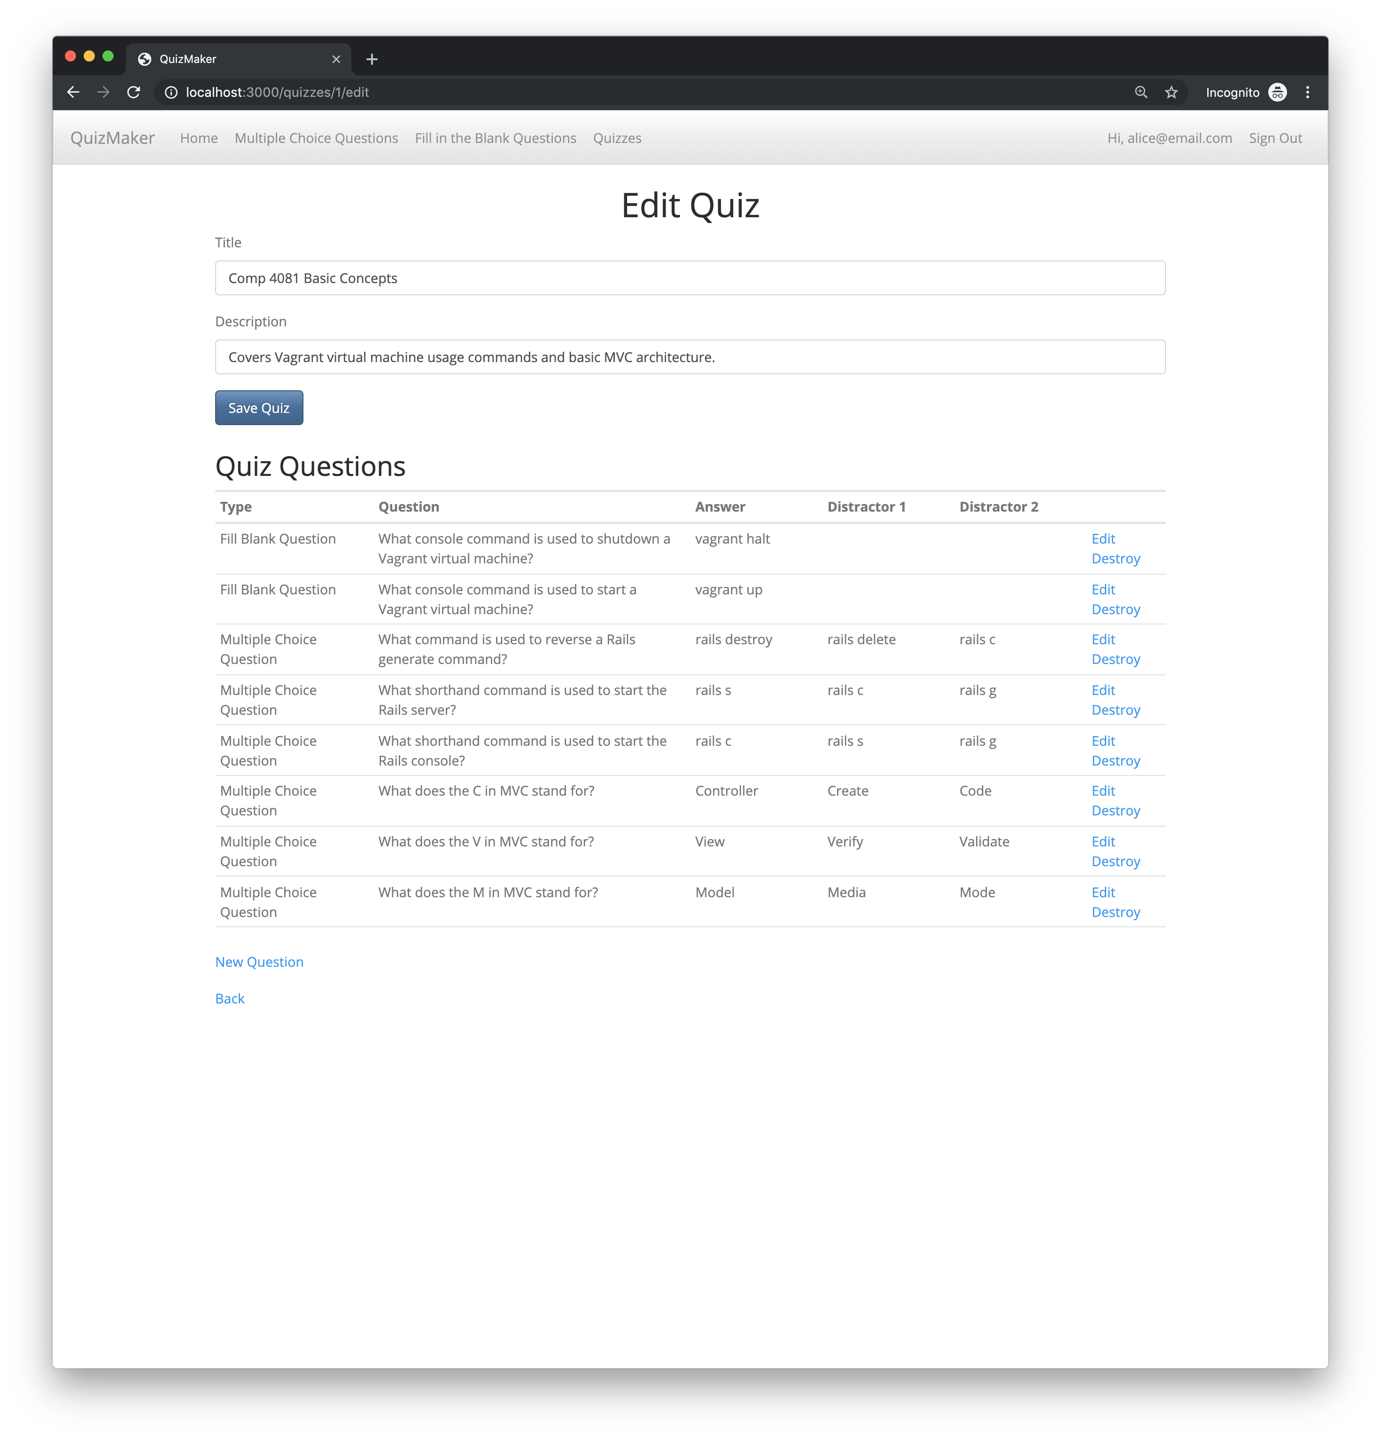
Coding Apps in Rails =
Creating a Custom Server
Define how to respond to different requests
Define HTML to be sent to clients
Browser
Rails Server
HTTP Requests
HTTP Responses

Slide 12
Summary
Client-Server Web Architecture
URLs
Hypertext Transfer Protocol (HTTP)
GET/POST/PATCH/DELETE Requests
Response format
“spider web” by Mario A. P. is licensed under CC BY-SA 2.0 / Cropped, color adjusted from original

