Slide 1
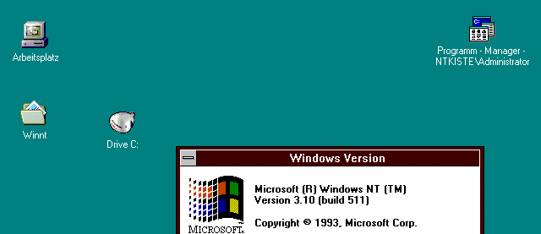
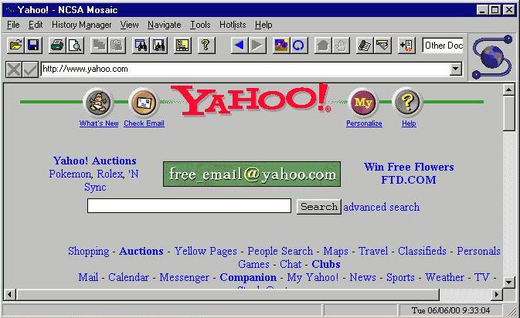
HTML
http://www.computerhistory.org/timeline/images/1993_mosaic_browser_large.jpg
Notes:
1993 version of Mosaic browser.
Loading Yahoo! from June 2000 (see lower right of browser window).

Slide 2
What is HTML?
Implies links
Implies formatting tags
HyperText Markup Language
Main language for writing web pages that
can be displayed in a web browser

Slide 3
Web Pages = 3 Technologies
HTML for Structure
Cascading Style Sheets (CSS) for Style
JavaScript for Behavior

Slide 4
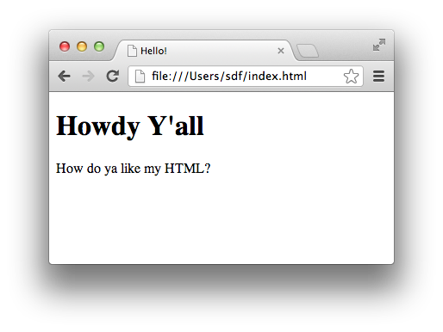
How HTML Works
You write HTML text
Then load it in a browser
<!DOCTYPE html>
<html>
<head>
<title>Hello!</title>
</head>
<body>
<h1>Howdy Y'all</h1>
<p>
How do ya like my HTML?
</p>
</body>
</html>

Slide 5
HTML Elements
Start tag
End tag
<p>This is a paragraph.</p>
Renders as
Note slash!
This is a paragraph.

Slide 6
Nesting Elements
Nested element
<p>This is a <b>paragraph</b>.</p>
Renders as
This is a paragraph.

Slide 7
Element Attributes
Attribute
<p style="color:blue">I'm blue!</p>
Renders as
Attribute
name
I’m blue!
Equals
Value
string

Slide 8
HTML Page Structure
Doctype info
<!DOCTYPE html>
<html>
<head>
<title>Hello!</title>
</head>
<body>
<h1>Howdy Y'all</h1>
<p>
How do ya like my HTML?
</p>
</body>
</html>
head element for metadata
html element
body element for content

Slide 9
Oh Yeah, and …
A few tags don’t come in pairs:
  E.g.: <br> for line breaks
  E.g.: <img> for images
Browsers collapse whitespace (spaces, newlines):
  Consecutive whitespace treated as single space
  Leading/trailing whitespace eliminated
Special symbols:
  E.g.: &nbsp; for non-breaking space
  See: http://www.w3schools.com/html/html_entities.asp and http://www.w3schools.com/tags/ref_symbols.asp

Slide 10
Now, all you need to do is learn these tags:
http://www.w3schools.com/tags/ref_byfunc.asp
(Ignore any “not supported” ones)

Slide 11
Summary
HTML, CSS, and JavaScript
HTML elements
Element attributes
HTML page structure

