Slide 1
How new/create form requests are processed
Dataflow view

Slide 2

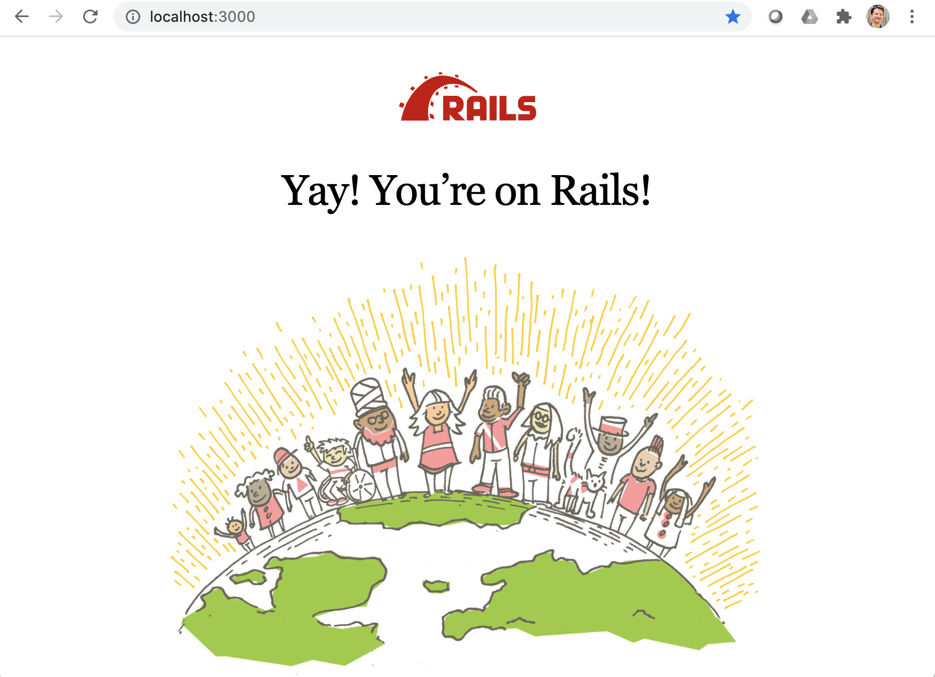
Ye Olde
Internet
Web Server
Browser
Router
Controller
View
Model
DB

Slide 3
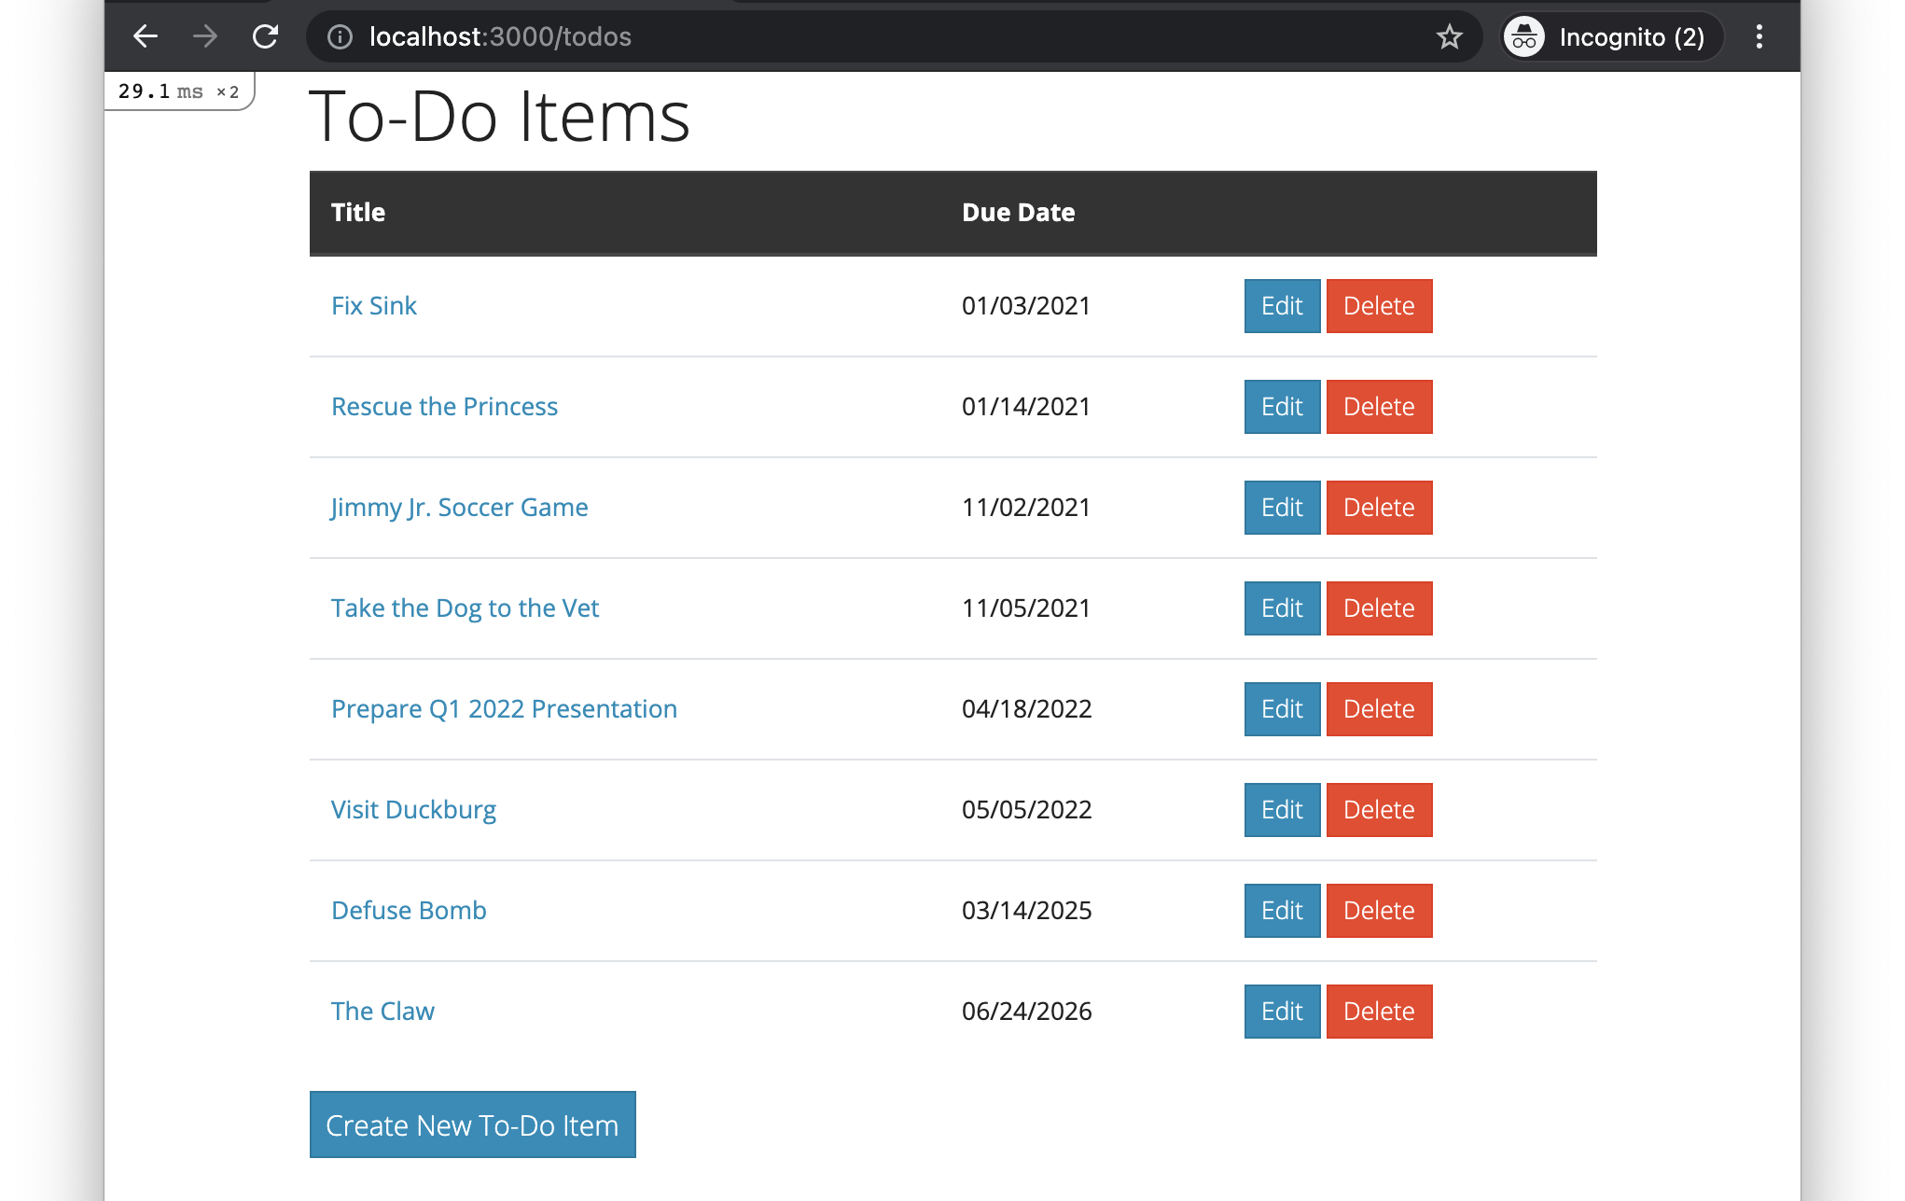
User presses button (link)

Slide 4
Ye Olde
Internet
Web Server
Browser sends HTTP GET request
Browser
Router
Controller
View
Model
DB

Slide 5
Ye Olde
Internet
Web Server
Router looks up route that matches the request, and calls controller action
Browser
Router
Controller
View
Model
DB

Slide 6
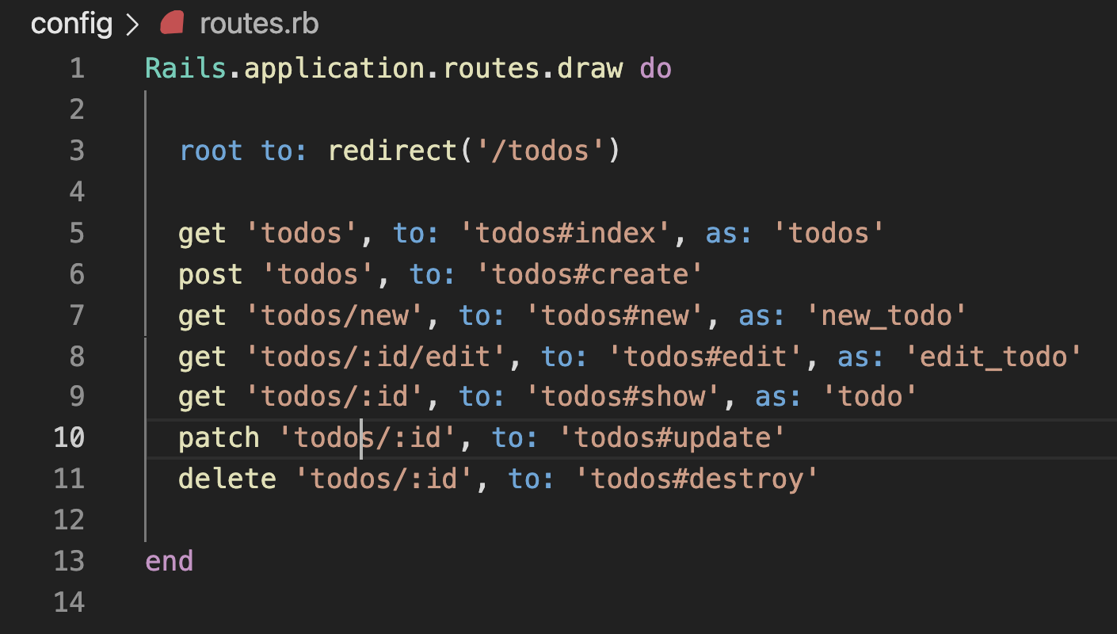
For HTTP GET requests with “todos/new” as resource path…
… call the new method of the TodosController class

Slide 7
Ye Olde
Internet
Web Server
Router looks up route that matches the request, and calls controller action
Browser
Router
Controller
View
Model
DB

Slide 8
Ye Olde
Internet
Web Server
Browser
Router
Controller action calls model method
Controller
View
Model
DB

Slide 9
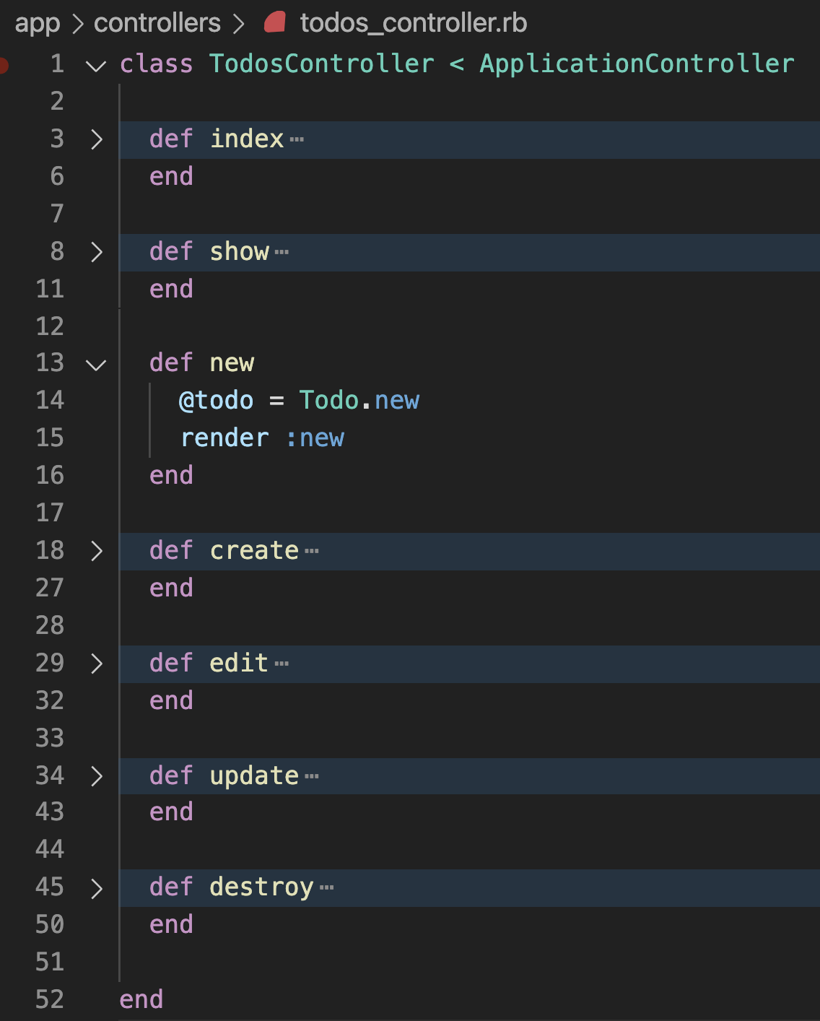

Slide 10
Ye Olde
Internet
Web Server
Browser
Router
Controller action calls model method
Controller
View
Model
DB

Slide 11
Ye Olde
Internet
Web Server
Browser
Router
Controller
View
Model method returns
Model
DB

Slide 12
Ye Olde
Internet
Web Server
Browser
Router
Controller action renders a view template
Controller
View
Model
DB

Slide 14
Ye Olde
Internet
Web Server
Browser
Router
Controller action renders a view template
Controller
View
Model
DB

Slide 15
Ye Olde
Internet
Web Server
Browser
Router
View template generates HTML
Controller
View
Model
DB

Slide 16
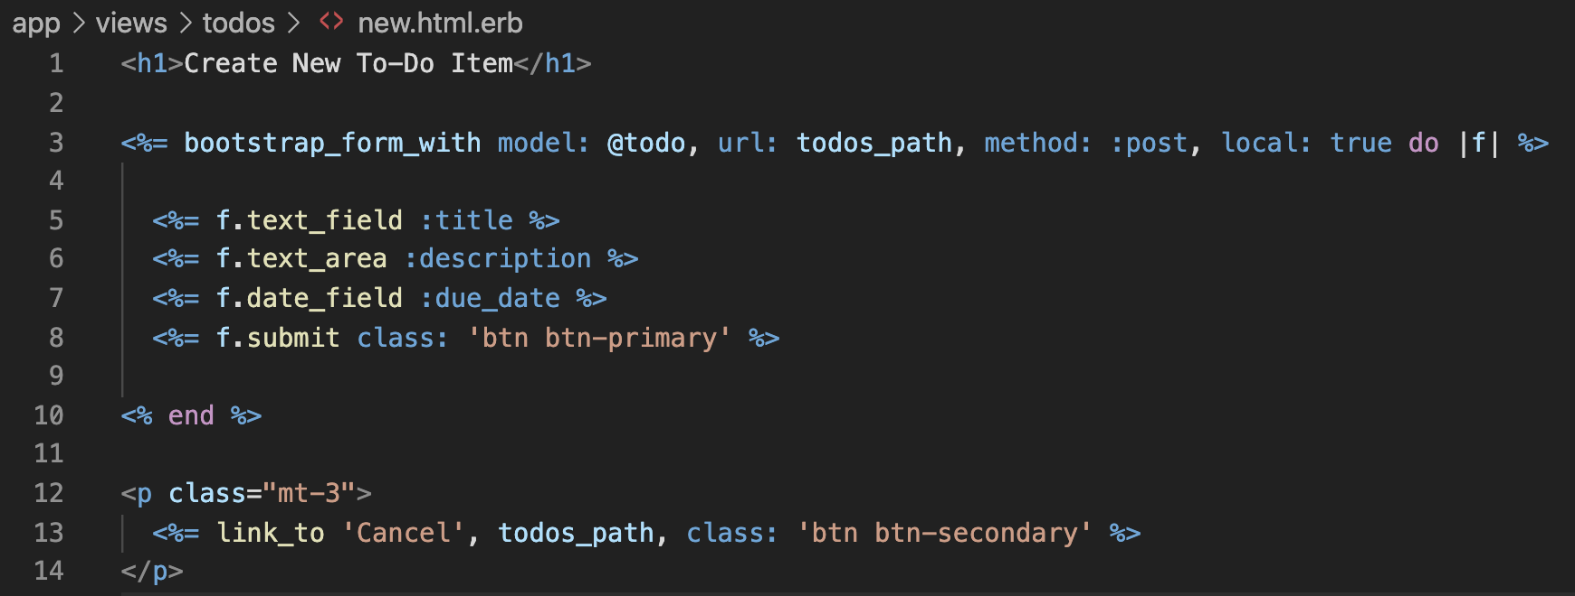

Slide 17
Ye Olde
Internet
Web Server
Browser
Router
View template generates HTML
Controller
View
Model
DB

Slide 18
Ye Olde
Internet
Web Server
Controller sends an HTTP response, containing the generated HTML, to the browser
Browser
Router
Controller
View
Model
DB

Slide 19
Browser displays a webpage based on the HTML received
Ye Olde
Internet
Web Server
Browser
Router
Controller
View
Model
DB

Slide 20
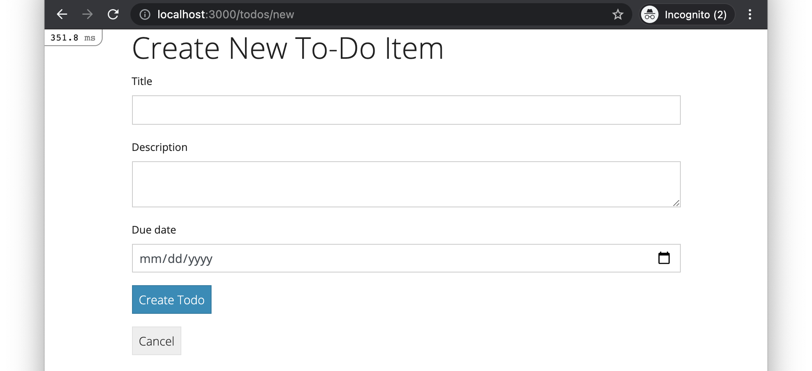

Slide 21
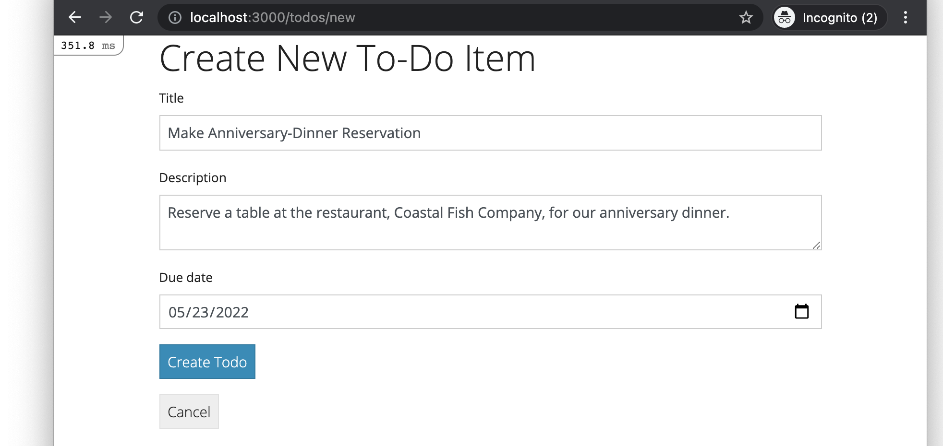
User fills out form and presses button

Slide 22
Ye Olde
Internet
Web Server
Browser sends HTTP POST request
Browser
Router
Controller
View
Model
DB

Slide 23
Set POST request
Set resource path in request to “/todos”

Slide 24
Ye Olde
Internet
Web Server
Browser sends HTTP POST request
Browser
Router
Controller
View
Model
DB

Slide 25
Ye Olde
Internet
Web Server
Router looks up route that matches the request, and calls controller action
Browser
Router
Controller
View
Model
DB

Slide 26
For HTTP POST requests with “todos” as resource path…
… call the create method of the TodosController class

Slide 27
Ye Olde
Internet
Web Server
Router looks up route that matches the request, and calls controller action
Browser
Router
Controller
View
Model
DB

Slide 28
Ye Olde
Internet
Web Server
Browser
Router
Controller action calls model method
Controller
View
Model
DB

Slide 29
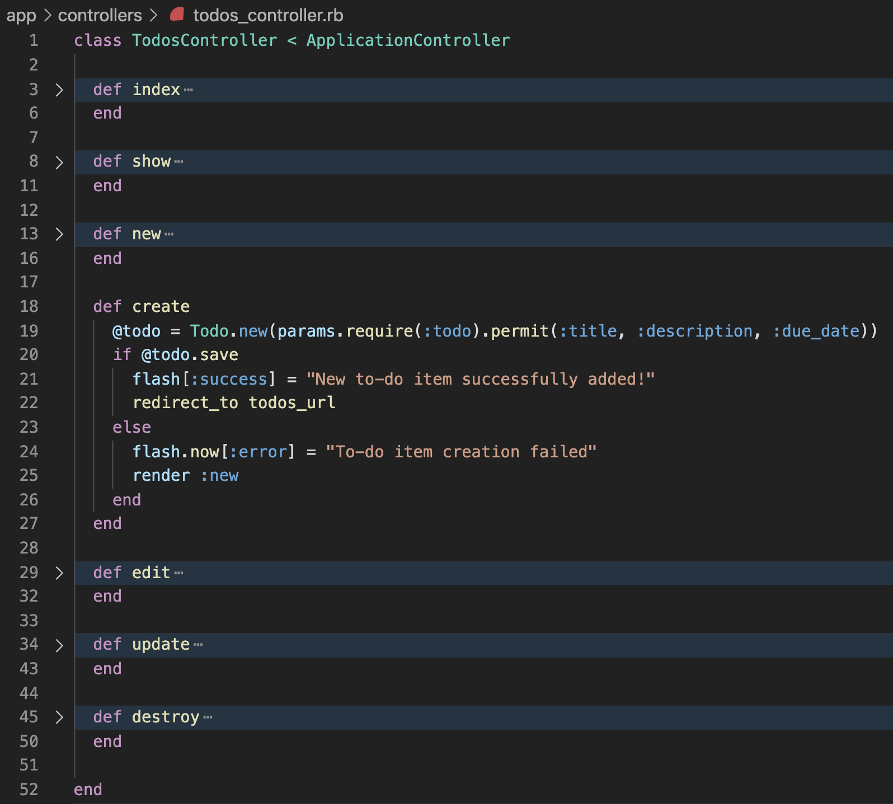

Slide 30
Create a new Todo object, but don’t save it to the database (yet)
… initialize the object with the data that the user filled into the form, which is stored in the params hash

Slide 31
The params hash is
structured like this…
params = {
todo: {
title: '…',
description: '…',
due_date: …
}
}

Slide 32
This form helper argument determined the structure of the form data in the params hash
params = {
todo: {
title: '…',
description: '…',
due_date: …
}
}

Slide 33
Requires that there is a top-level :todo key in the params hash; otherwise, throw an exception
params = {
todo: {
title: '…',
description: '…',
due_date: …
}
}
For the hash returned by params[:todo], filters out all data, except those for the specified keys

Slide 34
Ye Olde
Internet
Web Server
Browser
Router
Controller action calls model method
Controller
View
Model
DB

Slide 35
Ye Olde
Internet
Web Server
Browser
Router
Controller
View
Model method returns
Model
DB

Slide 36
Ye Olde
Internet
Web Server
Browser
Router
Controller action calls model method
Controller
View
Model
DB

Slide 38
Ye Olde
Internet
Web Server
Browser
Router
Controller action calls model method
Controller
View
Model
DB

Slide 39
Ye Olde
Internet
Web Server
Browser
Router
Controller
View
Model invokes SQL operation
Model
DB

Slide 40
Ye Olde
Internet
Web Server
Browser
Router
Controller
View
Model
DB performs operation and responds
DB

Slide 41
Ye Olde
Internet
Web Server
Browser
Router
Controller
View
Model method returns
Model
DB

Slide 42
Ye Olde
Internet
Web Server
Controller sets the flash message and sends an HTTP redirect response to the browser
Browser
Router
Controller
View
Model
DB

Slide 44
Ye Olde
Internet
Web Server
Controller sets the flash message and sends an HTTP redirect response to the browser
Browser
Router
Controller
View
Model
DB

Slide 45
Ye Olde
Internet
Web Server
Browser automatically sends HTTP GET request
Browser
Router
Controller
View
Model
DB

Slide 46
Ye Olde
Internet
Web Server
Processing of request for index page happens as in previous lecture
Browser
Router
Controller
View
Model
DB

Slide 47
Browser displays a webpage based on the HTML received
Ye Olde
Internet
Web Server
Browser
Router
Controller
View
Model
DB

Slide 48
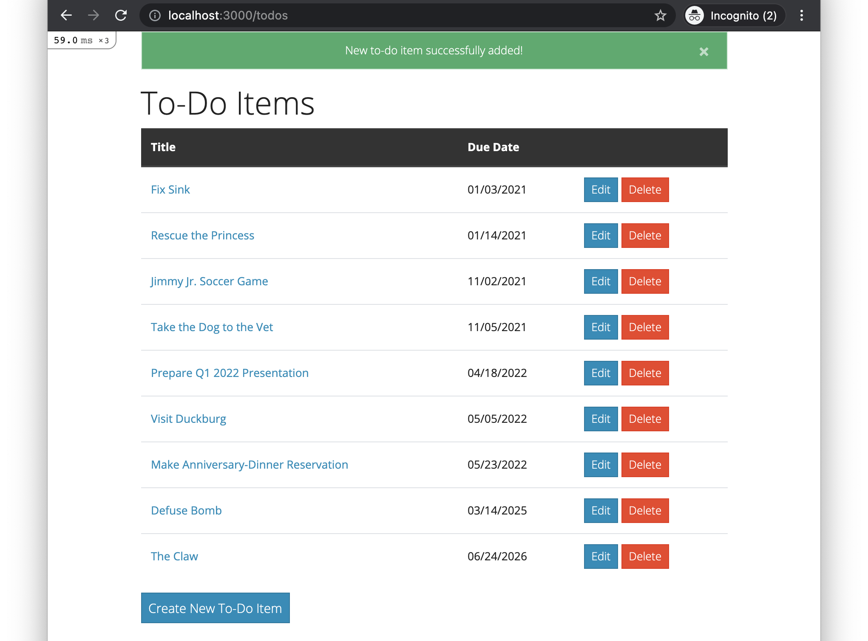
Flash message displays
New to-do item displays

