Slide 1
How an index page request is processed
Dataflow view

Slide 2
How an index page request is processed
Dataflow view
The Quick Version

Slide 3
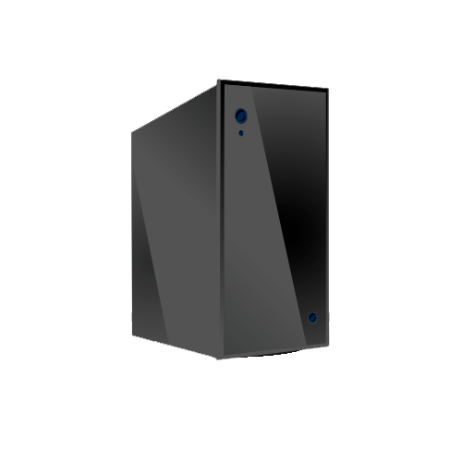
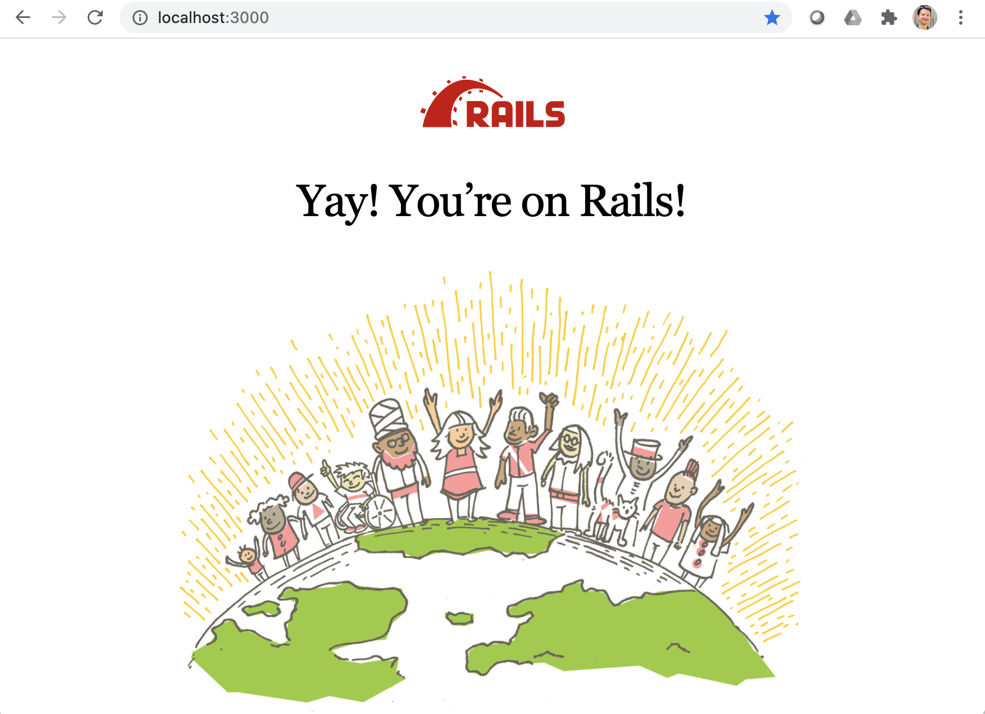
Ye Olde
Internet
Web Server
Browser
Router
Controller
View
Model
DB

Slide 4
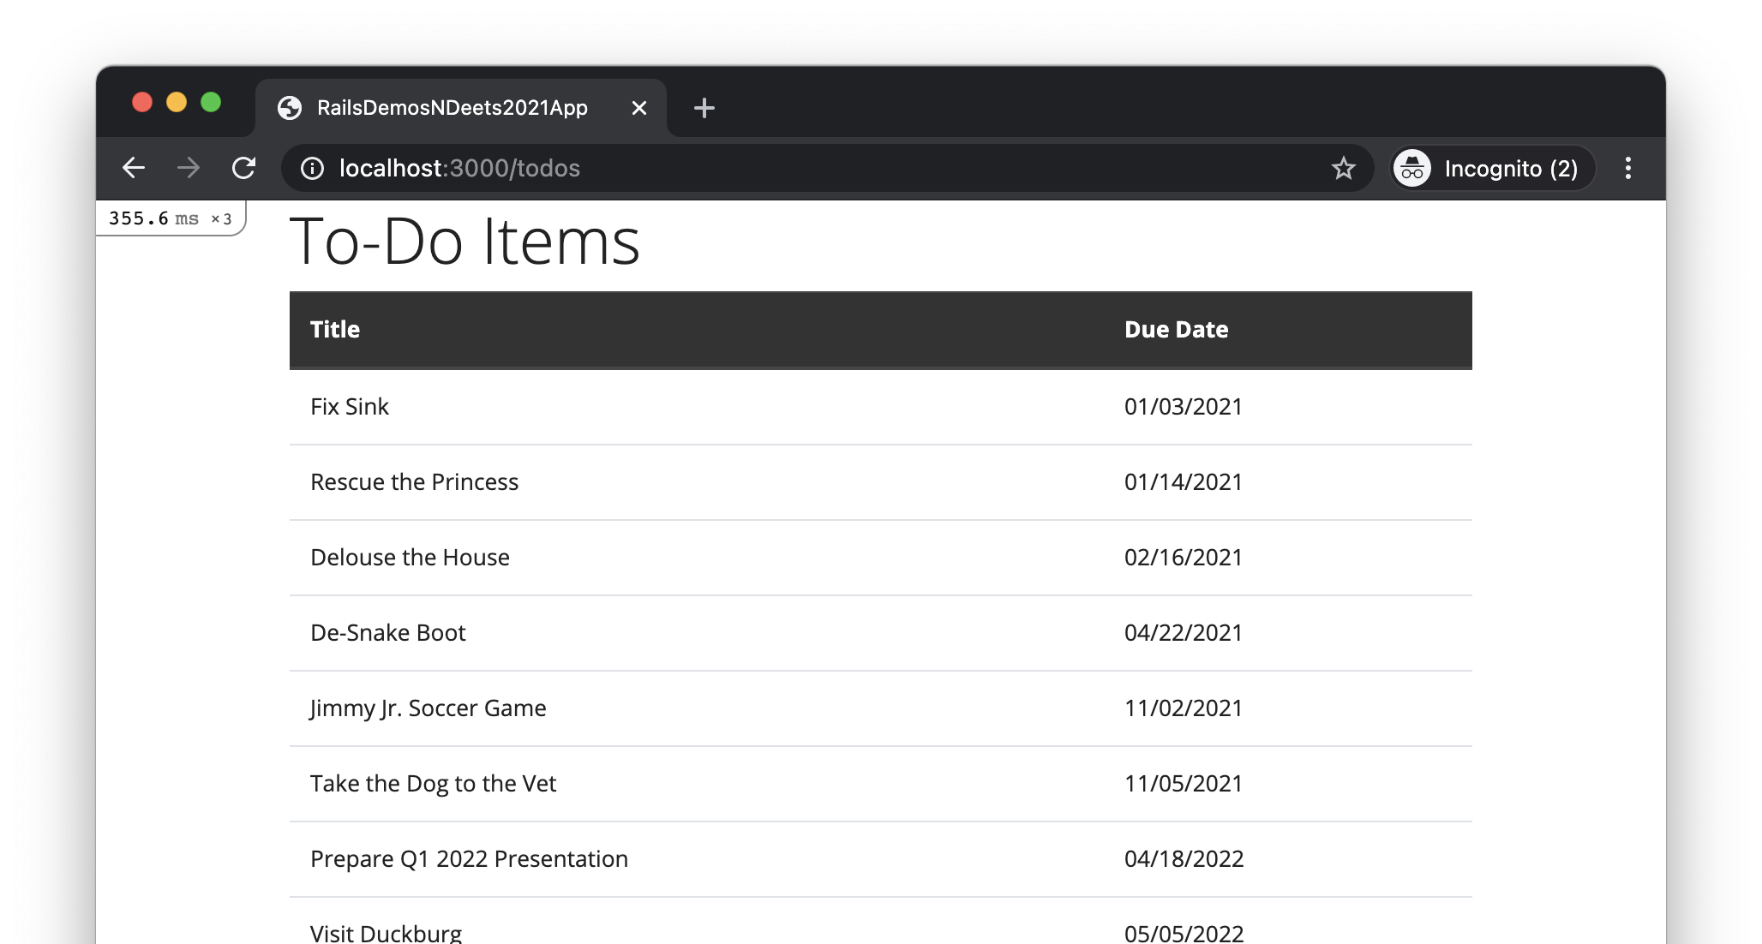
User enters URL into location bar

Slide 5
Ye Olde
Internet
Web Server
Browser sends HTTP GET request
Browser
Router
Controller
View
Model
DB

Slide 6
Ye Olde
Internet
Web Server
Router looks up route that matches the request, and calls controller action
Browser
Router
Controller
View
Model
DB

Slide 7
Ye Olde
Internet
Web Server
Browser
Router
Controller action calls model method
Controller
View
Model
DB

Slide 8
Ye Olde
Internet
Web Server
Browser
Router
Controller
View
Model invokes SQL operation
Model
DB

Slide 9
Ye Olde
Internet
Web Server
Browser
Router
Controller
View
Model
DB performs operation and responds
DB

Slide 10
Ye Olde
Internet
Web Server
Browser
Router
Controller
View
Model method returns
Model
DB

Slide 11
Ye Olde
Internet
Web Server
Browser
Router
Controller action renders a view template
Controller
View
Model
DB

Slide 12
Ye Olde
Internet
Web Server
Browser
Router
View template generates HTML
Controller
View
Model
DB

Slide 13
Ye Olde
Internet
Web Server
Controller sends an HTTP response, containing the generated HTML, to the browser
Browser
Router
Controller
View
Model
DB

Slide 14
Browser displays a webpage based on the HTML received
Ye Olde
Internet
Web Server
Browser
Router
Controller
View
Model
DB

Slide 16
How an index page request is processed
Dataflow view
The Long Version

Slide 17
Ye Olde
Internet
Web Server
Browser
Router
Controller
View
Model
DB

Slide 18
User enters URL into location bar

Slide 19
Ye Olde
Internet
Web Server
Browser sends HTTP GET request
Browser
Router
Controller
View
Model
DB

Slide 20
Ye Olde
Internet
Web Server
Router looks up route that matches the request, and calls controller action
Browser
Router
Controller
View
Model
DB

Slide 21
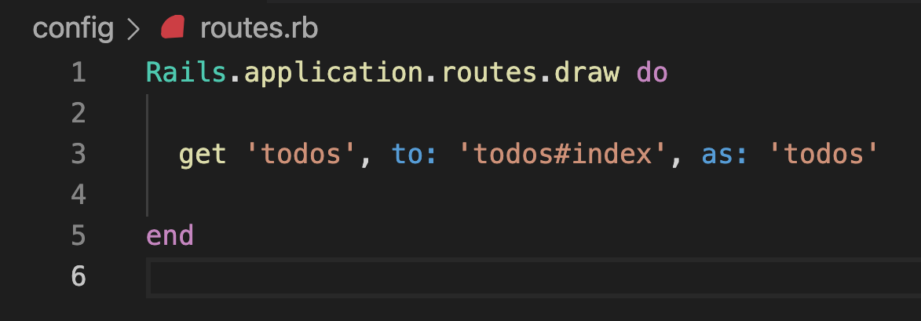
For HTTP GET requests with “todos” as resource path…
… call the index method of the TodosController class

Slide 22
Ye Olde
Internet
Web Server
Router looks up route that matches the request, and calls controller action
Browser
Router
Controller
View
Model
DB

Slide 23
Ye Olde
Internet
Web Server
Browser
Router
Controller action calls model method
Controller
View
Model
DB

Slide 24
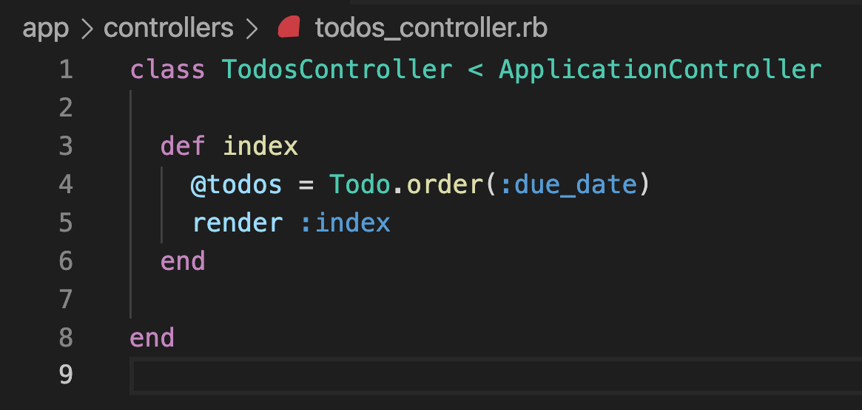

Slide 25
Ye Olde
Internet
Web Server
Browser
Router
Controller action calls model method
Controller
View
Model
DB

Slide 26
Ye Olde
Internet
Web Server
Browser
Router
Controller
View
Model invokes SQL operation
Model
DB

Slide 27
Ye Olde
Internet
Web Server
Browser
Router
Controller
View
Model
DB performs operation and responds
DB

Slide 28
Ye Olde
Internet
Web Server
Browser
Router
Controller
View
Model method returns
Model
DB

Slide 29
Ye Olde
Internet
Web Server
Browser
Router
Controller action renders a view template
Controller
View
Model
DB

Slide 31
Ye Olde
Internet
Web Server
Browser
Router
Controller action renders a view template
Controller
View
Model
DB

Slide 32
Ye Olde
Internet
Web Server
Browser
Router
View template generates HTML
Controller
View
Model
DB

Slide 33
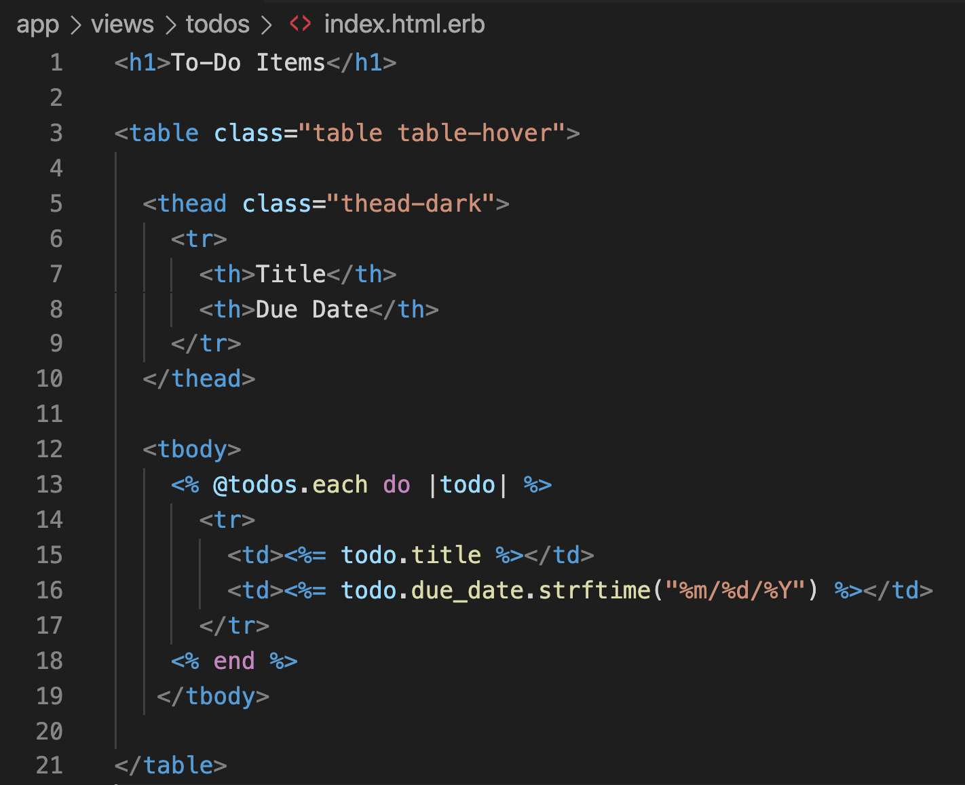

Slide 34
Ye Olde
Internet
Web Server
Browser
Router
View template generates HTML
Controller
View
Model
DB

Slide 35
Ye Olde
Internet
Web Server
Controller sends an HTTP response, containing the generated HTML, to the browser
Browser
Router
Controller
View
Model
DB

Slide 36
Browser displays a webpage based on the HTML received
Ye Olde
Internet
Web Server
Browser
Router
Controller
View
Model
DB

